Slide 1
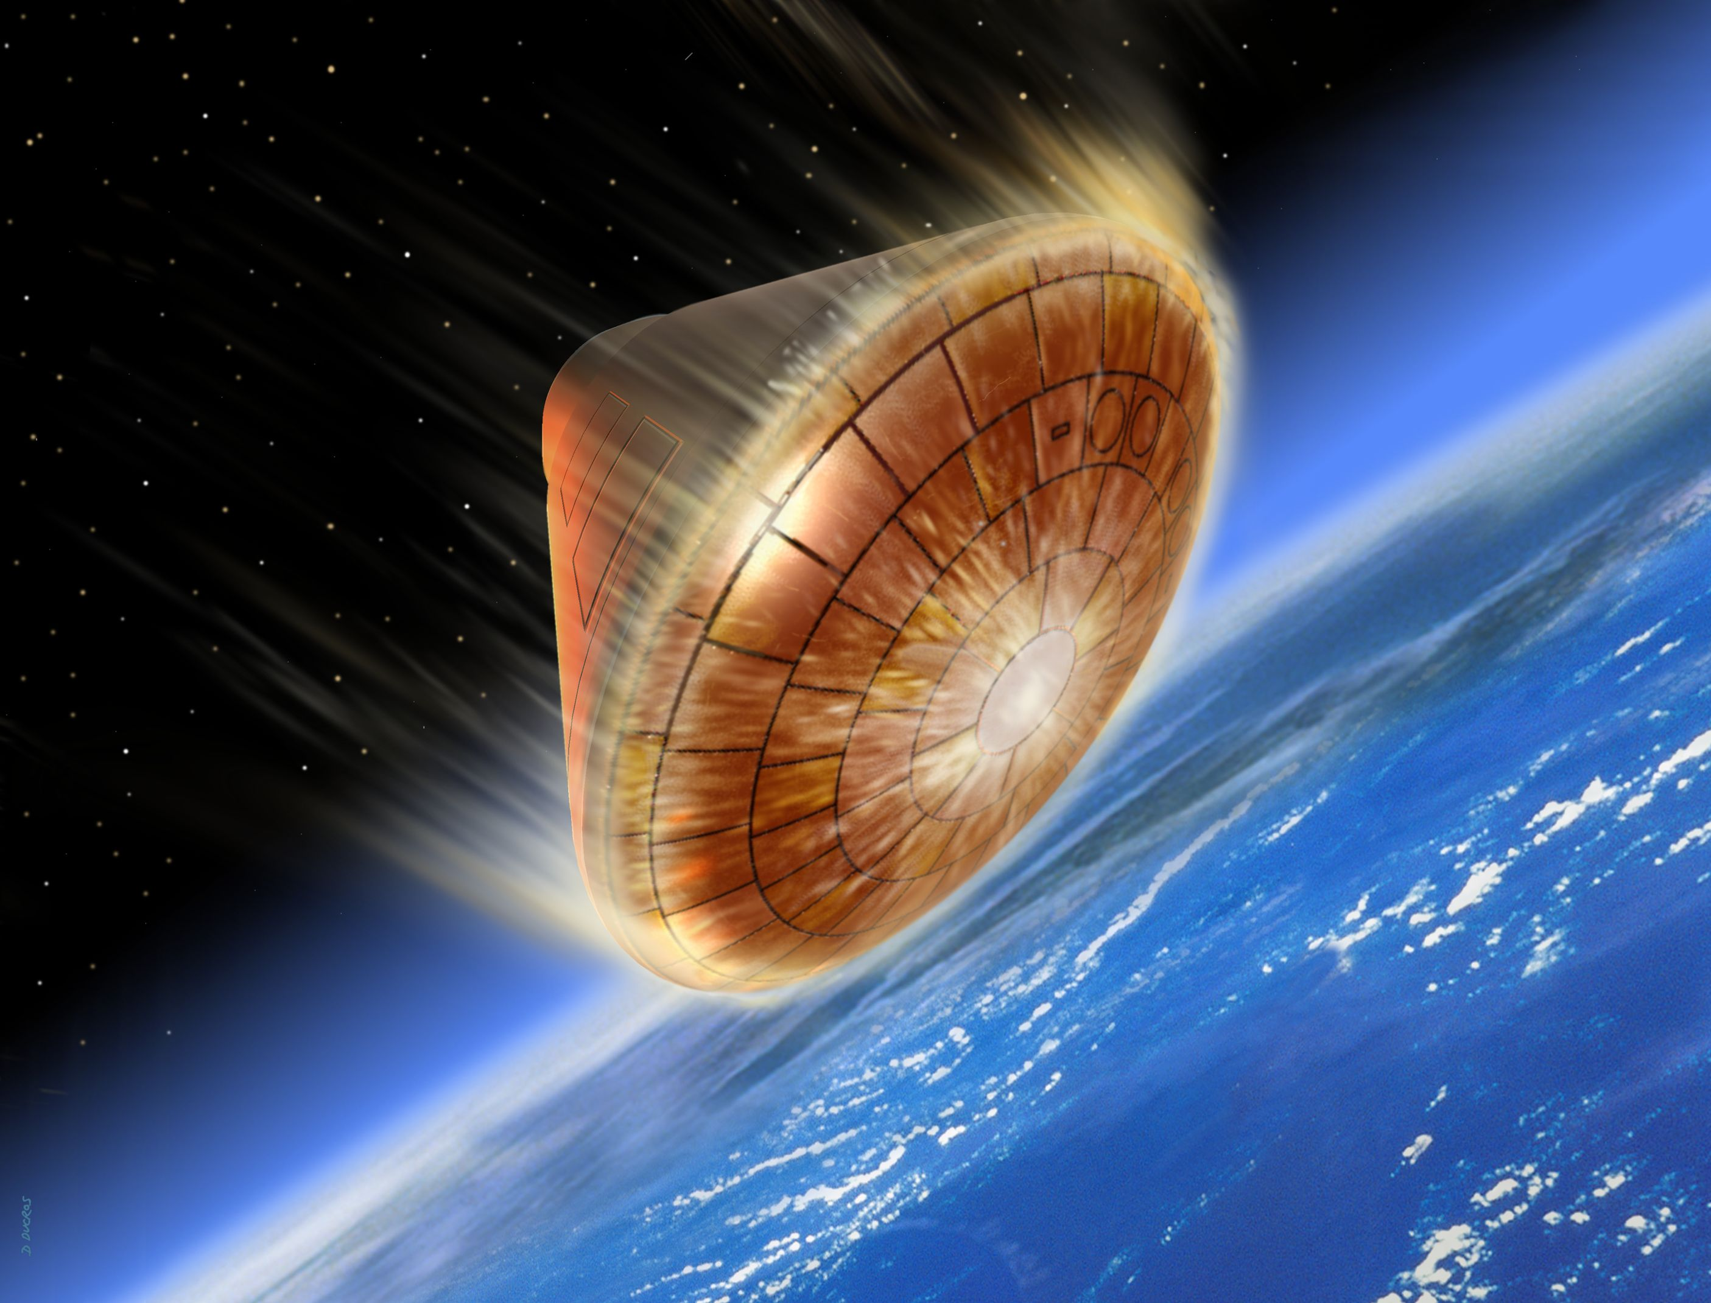
Atmospheric Re-entry 3 Dimensional heat modeling
Justin de la Serna

Slide 2
Methods
Solve the 3 dimension heat equation by first establish the initial conditions and boundary conditions to be confined within a disk. Within the main iteration loop, boundaries are set to heat the exterior of the shield, allow the heat to precipitate throughout the craft while also keeping the edge of the disk heated.
Created a 3 dimensional image of the capsule by using polyval and graphics input in order to use the cylinder function and rotate the spline from the polyval function around the z-axis.
Airflow was solved as a steady state solution, where the only variation occurring through the iterations is the radius of the “pipe”. The velocity of the aircraft exceeds modelable mach numbers upon reentry, at least beyond the capabilities of matlab. Therefore, the system was treated as if it was traveling through a fluid, with varying densities. It can be assumed that the air density surrounding a space vehicle would behave more along the lines of a fluid rather than a gas at the speeds the ship is traveling. Turbulence poses another significant problem, and therefore the simplest means of modeling the flow of air around the craft (more like the air deflection) was by using a steady state fluid flow equation.
Why does the temperature around the leading edge stay constant for the entire simulation?
The leading edges of spacecraft withstand the highest degrees of drag, therefore friction, and therefore absorb the most heat. The heat absorbing material is essentially rated to withstand and hold at 2300 degrees Kelvin.

