Slide 1
Chaos Game Representation: Visualizing Genomes
Juneyoung Jeong

Slide 2
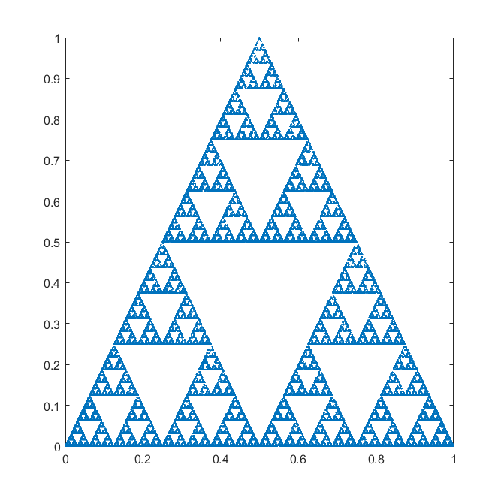
Playing the Game
Start at the center of a polygon
Randomly choose one corner
Plot midpoint between the corner and where you currently are
Repeat steps 2-3 several thousand times

Slide 3
Coding it up
Overall, pretty straightforward
Made two functions– call only ONE of them at a time!
  First to read the given sequence and play the game using DNA sequence
  Second only counted number of DNA bases, and randomized corner to travel
>73000 iterations, using sequence for HUMHBB (human beta globin region), read from txt file
Program can read txt files and ignore any non-DNA base character

Slide 4
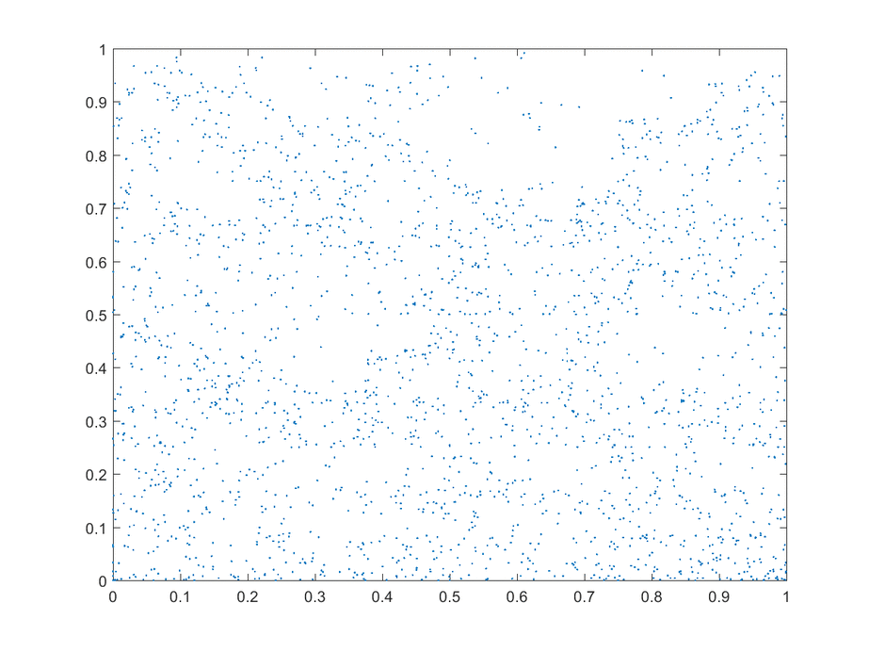
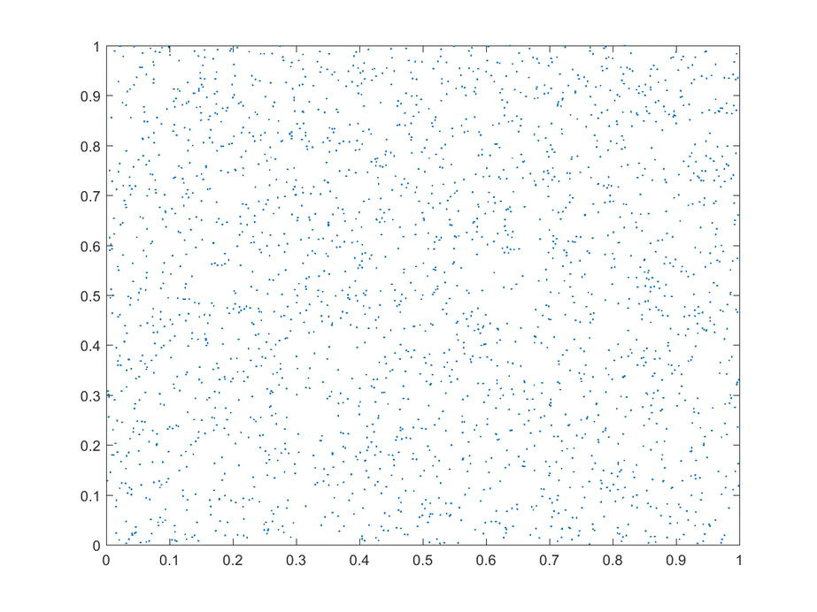
Will DNA-based CGR Hint at Structure?

Slide 5
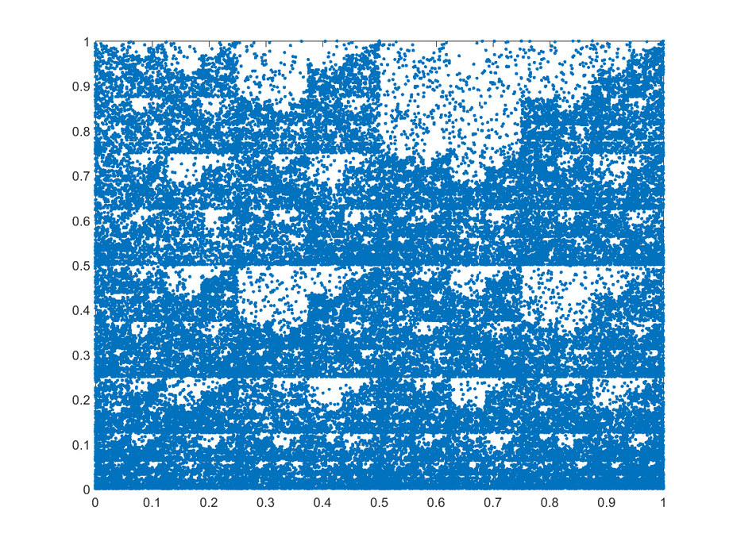
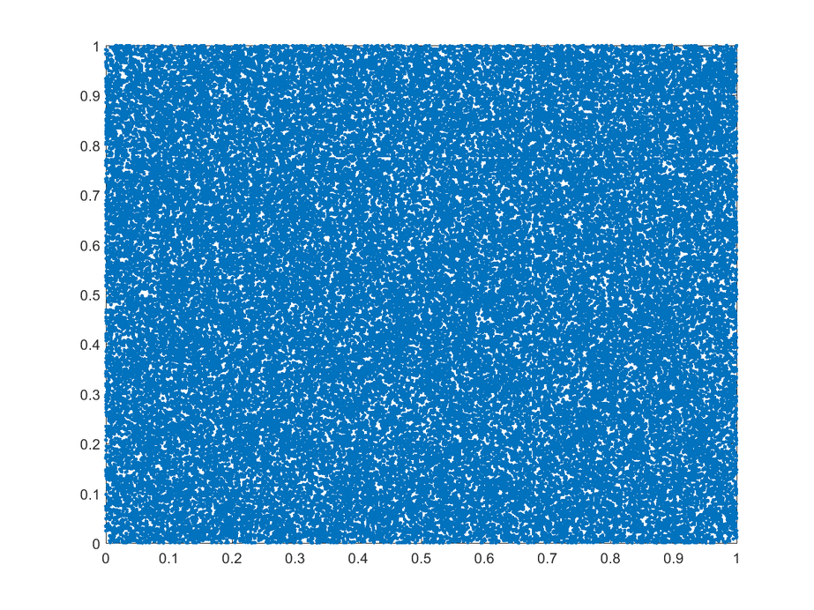
Fractal-like Self-Similarity

