Slide 1
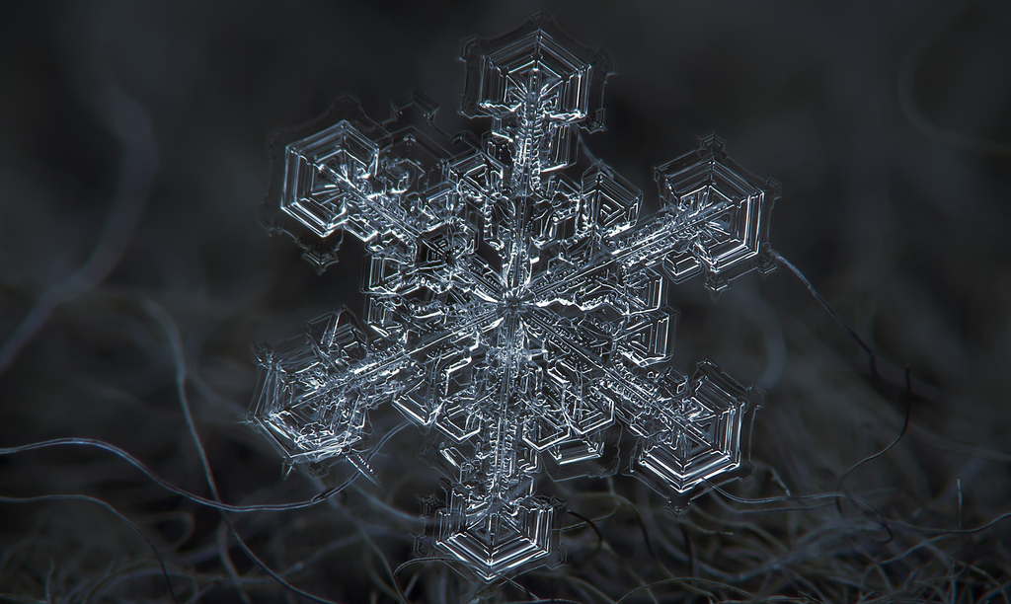
random generation of snow crystals with matlab
Michelle chang

Slide 2
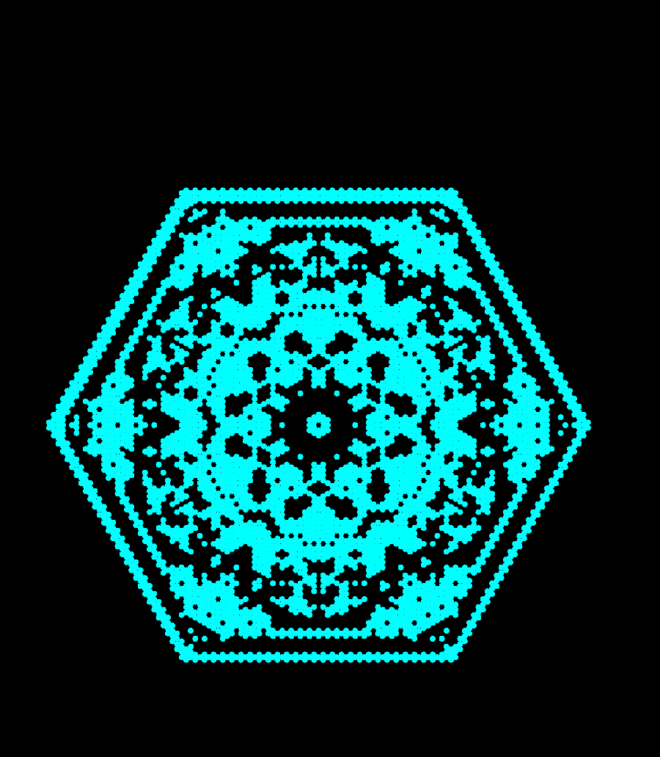
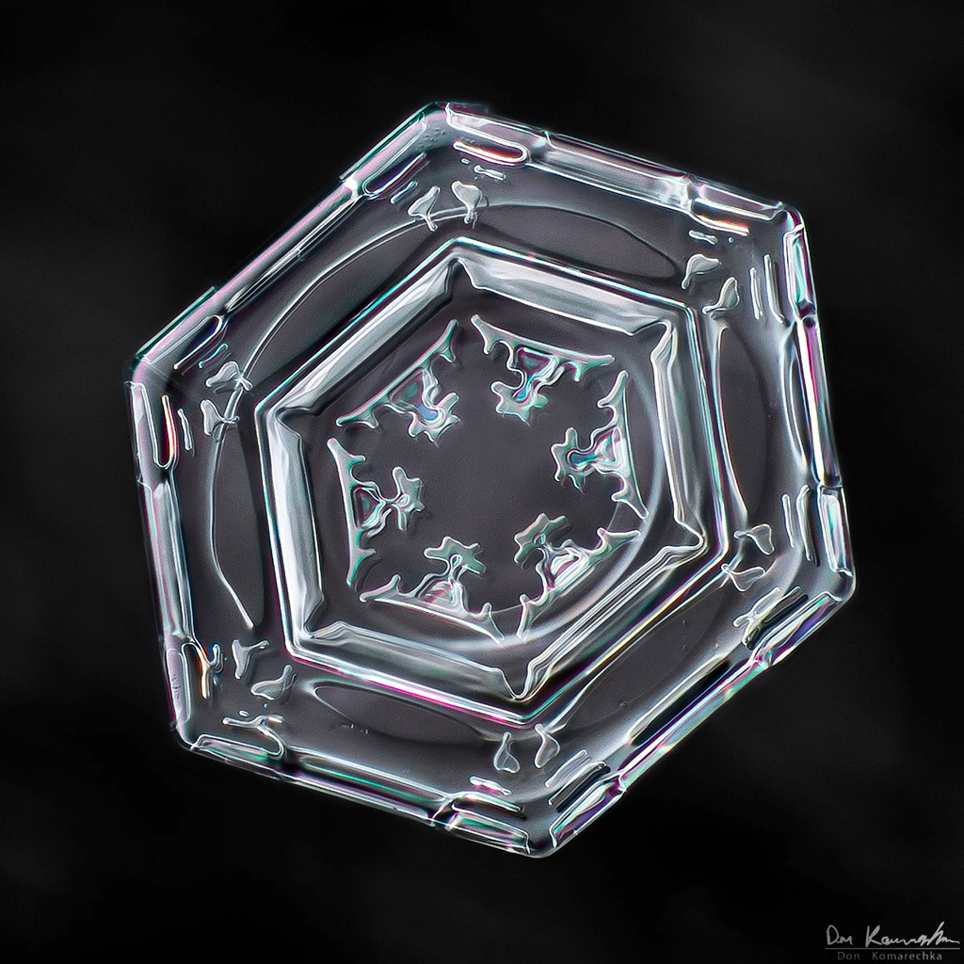
Method
Beauty > scientific accuracy
Procedure
Hexagonal grid
Distill crystal down to several basic cell states
Add randomness while preserving symmetry
Run process as cellular automata
To play simple snowflake: simple_snowflake.m
To play randomized versions: rand_flake_gen.m
Acknowledgements
plot_hexagonal_lattice.m, plot_hexagonal_lattice_point.m courtesy of Professor Burkhard Militzer
Algorithm based off Silvia Hao’s work (http://community.wolfram.com/groups/-/m/t/235291)

Slide 3
method: hexagonal grid
(3,3) => (2+1/2, 3*sqrt(3)/2)
sqrt(3)
1
sqrt(3)/2
1/2
(3,2) => (2,sqrt(3))
2

Slide 4
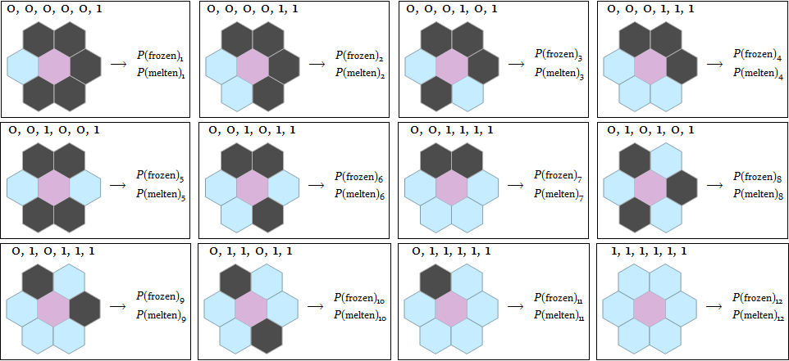
method: basic cell states
Each state has a freezing and melting probability

Slide 5
Simple Snowflake
Empty cells freeze if exactly one frozen neighbor

Slide 6
Random Generation
cell reaction depends on state category & manually-set melting/Freezing thresholds

Slide 7
Random Generation
cell reaction depends on state category & manually-set melting/Freezing thresholds

Slide 8
Further Reading
http://psoup.math.wisc.edu/Snowfakes.htm
Gravner-Griffeath snowflake model

