Slide 1
Simulating Solar System Formation
Harrison Agrusa

Slide 2
Method
Runge-Kutta used to solve ODE
Randomly generated masses, distances, velocities (within certain ranges)
Timestep = 4 days
Total time=109 years
50 particles
Start code with Nbody3D.m
Other files: Nbody_ode3D, inelastic_collisions3D.m

Slide 3
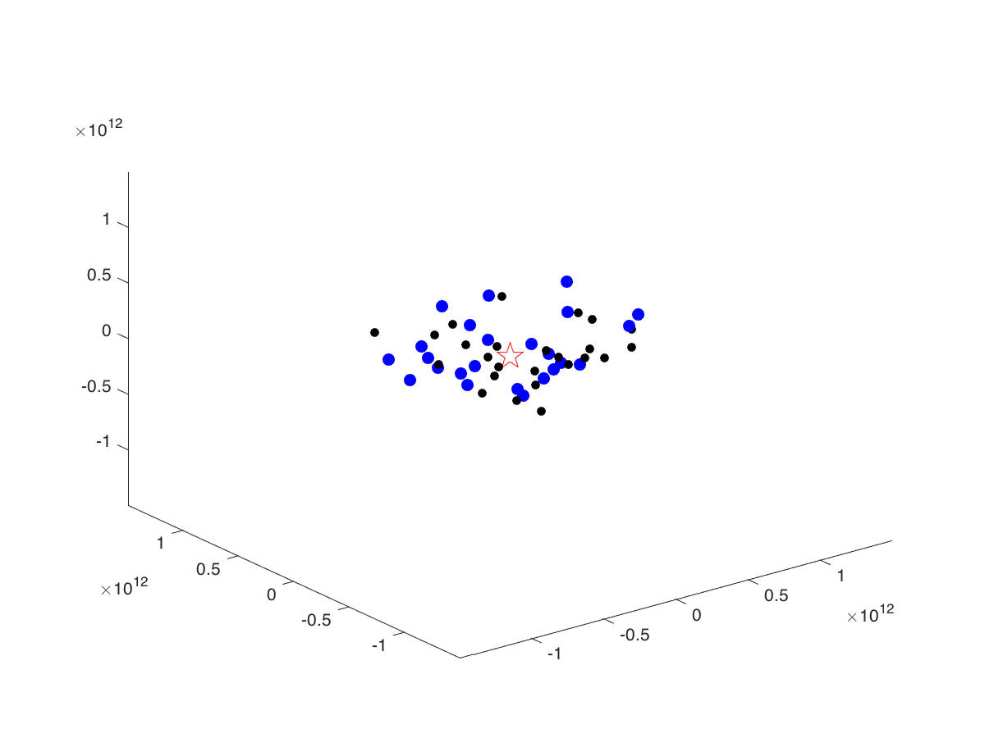
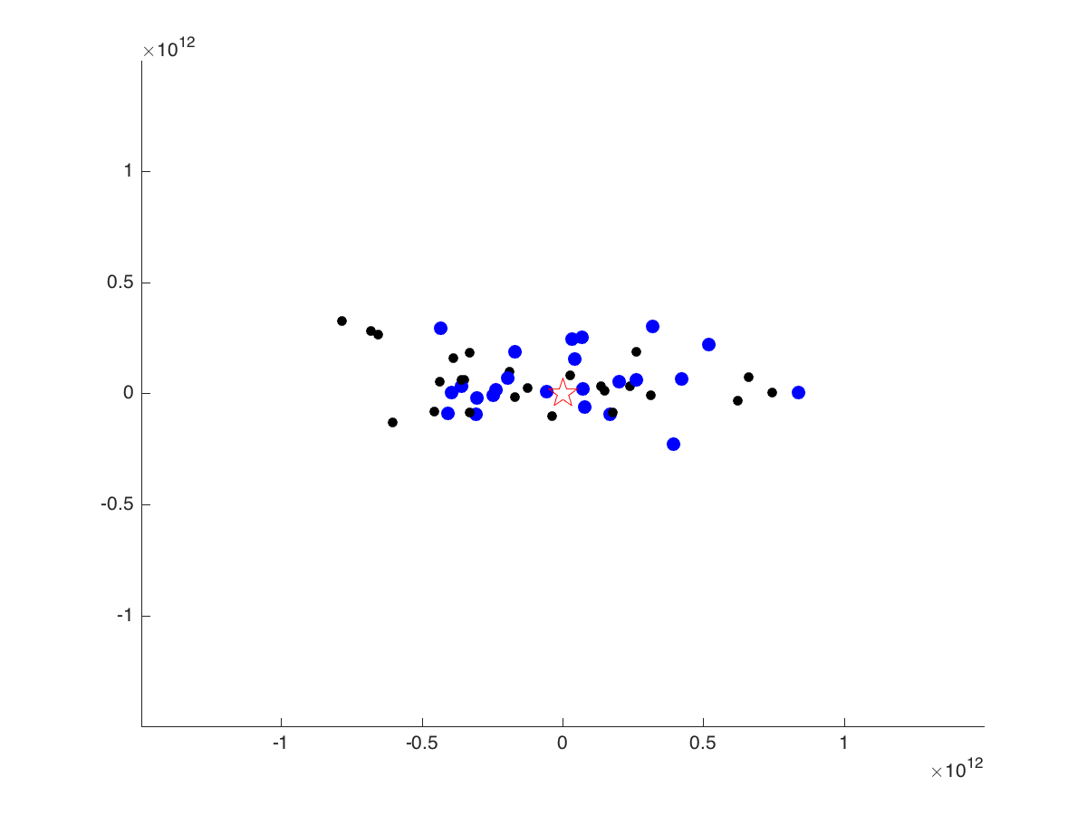
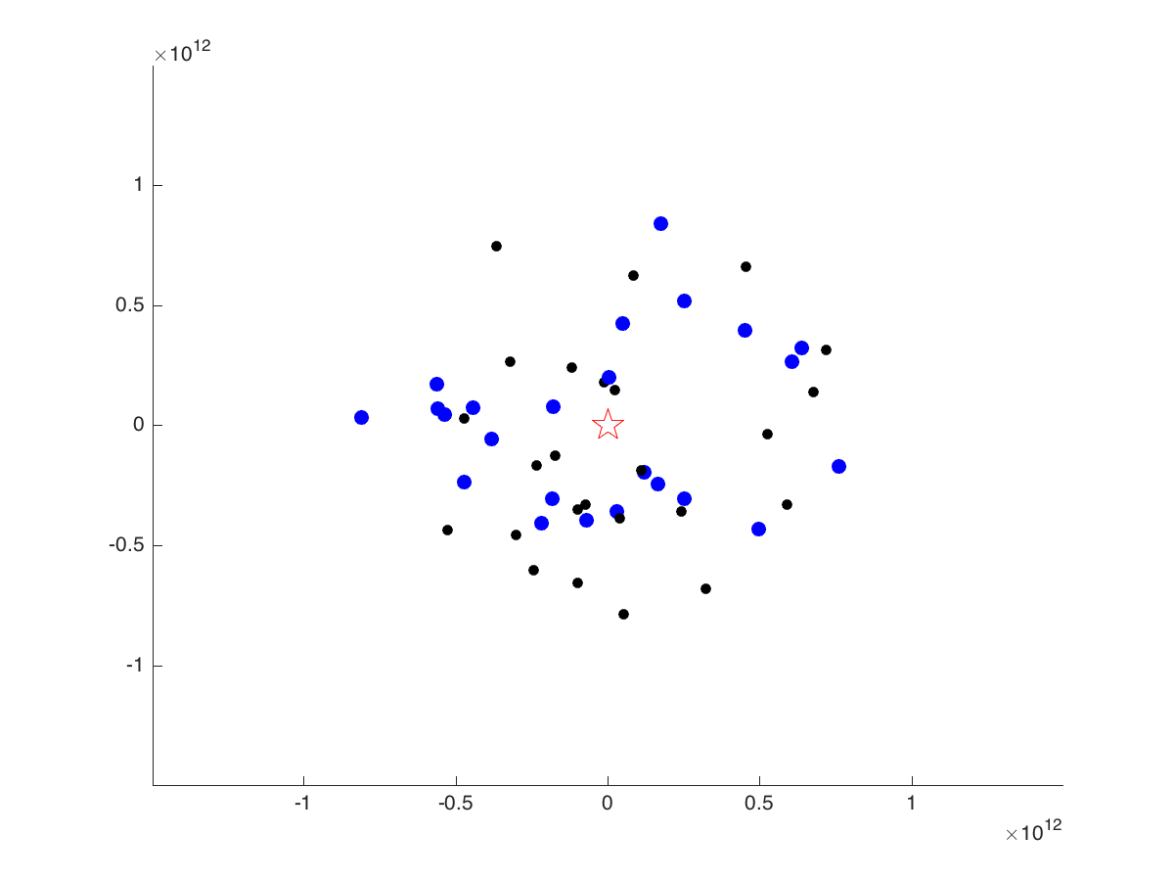
1 ‘Sun’, 24 ‘Earths’, 25 ‘Plutos’
View along x-axis
View along z-axis

Slide 4
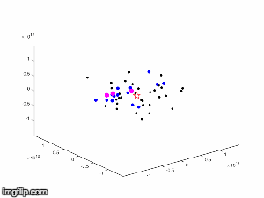
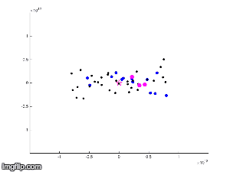
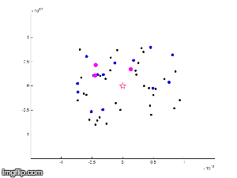
1 ‘Sun’,14 ‘Earths’, 32 ‘Plutos’, 3 ‘Jupiters’
View along x-axis
View along z-axis

Slide 5
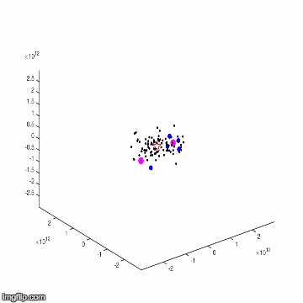
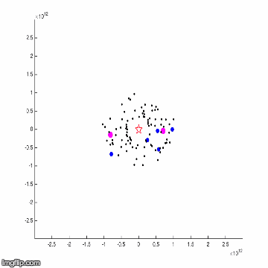
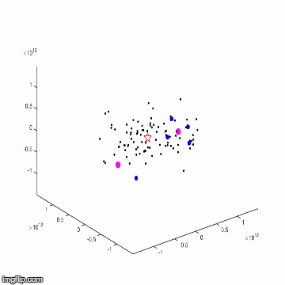
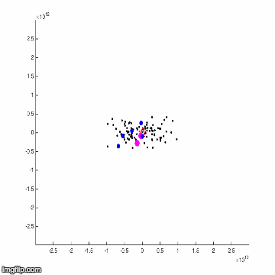
1 ‘Sun’, 5 ‘Earths’, 2 ‘Jupiters’, 92 asteroids
View from
Z-axis:
View from
X-axis:

