Slide 1
Mechanics of Wind Turbines
Aaron Lavine

Slide 2
Motivation
Alternative and sustainable solution to harvesting energy and generating electricity.
Wind power accounts for only 5.7% of total power generation in the US.
Efficient design and construction of these structures depends entirely on the mechanics each member experiences.
Mechanics in focus:
Forces and torque rotating the blades
Horizontal load bending the tower

Slide 3
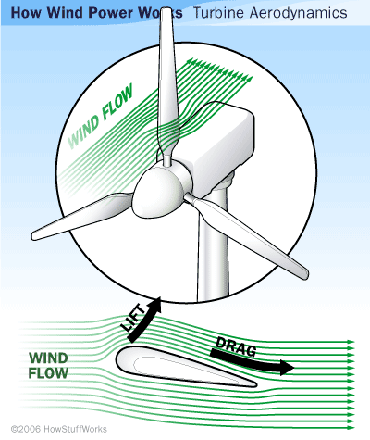
Blade Rotation Calculation

Slide 4
Rotation (Gusty Wind)

Slide 5
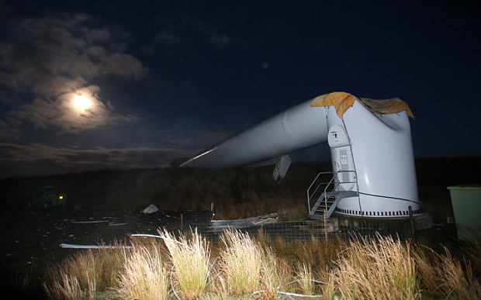
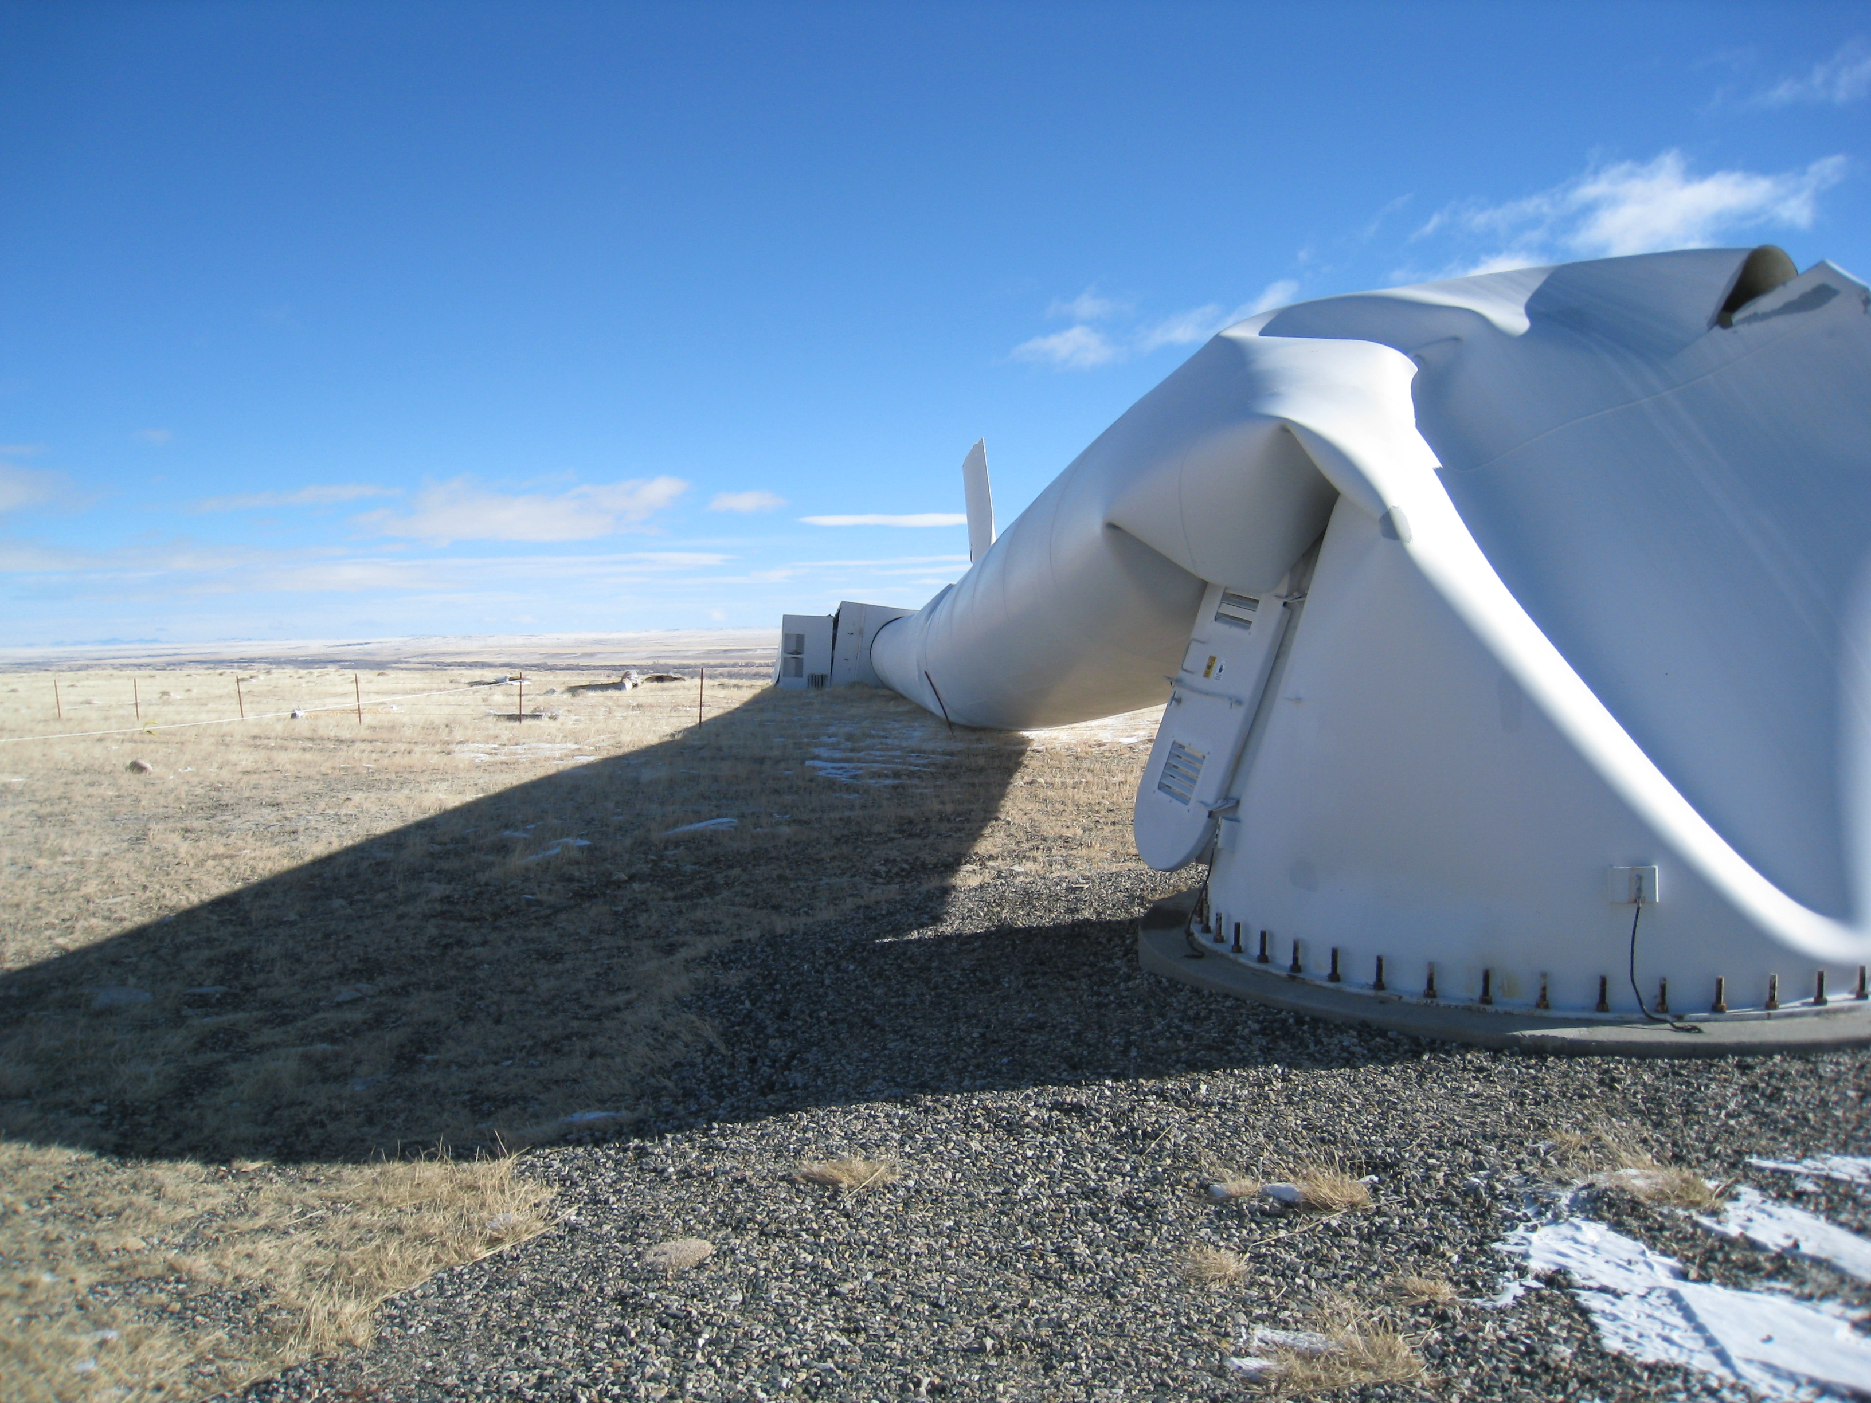
Bending Failure of Tower
What similarity do you notice in these two failures?

Slide 6
Free Body Diagram of Tower

Slide 7
Method: Discretization of Linear ODE
Equations and Definitions
Differentiation Form
Discretization Form

Slide 8
Tower Bending (Increasing Wind Speed)

Slide 9
Why does the tower fail at its base and not where it deflects the most?

