Slide 1
3D Octopus
EPS 109 Final Project
Jessica Kendall-Bar

Slide 2
Making the Octopus
RIGHT MOST ARM
Eight arms modeled by lines
These lines form a “skeleton”
To make the arms thicker,
Gaussian spheres were placed at
each coordinate of the line.
Radii of Gaussian spheres depend
on their distance along the line.
Graphics code to plot these Gaussian spheres by Gautam Vallabha
TOP RIGHT ARM
BOTTOM RIGHT ARM
TOP MIDDLE ARM
BOTTOM MIDDLE ARM
TOP LEFT ARM
BOTTOM LEFT ARM
LEFT MOST ARM

Slide 3
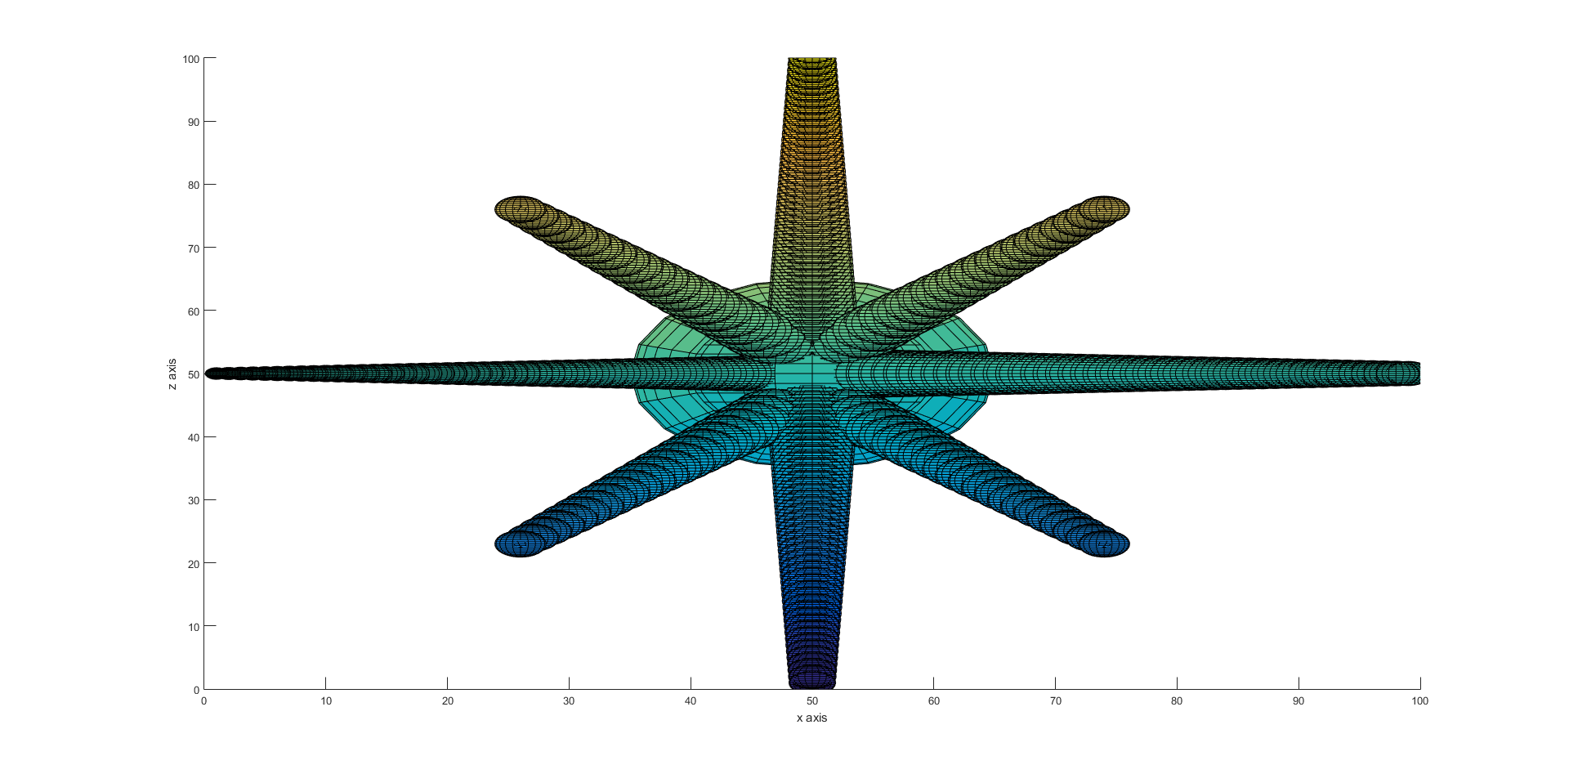
x axis
0 50 100
TOP MIDDLE ARM
50
0
TOP LEFT ARM
TOP RIGHT ARM
z axis
SIDE VIEW
LEFT MOST ARM
RIGHT MOST ARM
BOTTOM LEFT ARM
BOTTOM RIGHT ARM
BOTTOM MIDDLE ARM

Slide 4
x axis
Left and Right Arms
TOP-DOWN VIEW (xy plane)
z(k) = constant at N/2 or 50
100
LEFT ARM
i = j
RIGHT ARM
i = N-j
y(j)
50
100
0
50
x(i)
z axis

Slide 5
x axis
SIDE VIEW (yz plane)
x(i) = constant at N/2 or 50
100
TOP ARM
k = j
Top and Bottom Arms
z(k)
50
BOTTOM
ARM
k = N-j
0
50
y(j)
100
z axis

Slide 6
x axis
Bottom and Top:
Left & Right Arms
z axis

Slide 7
Top right and left z values:
z = 75 – y/2
k = 3*N/4 – j/2
Bottom and Top:
Left & Right Arms
z(k)
SIDE VIEW (yz plane)
TOP-DOWN VIEW (xy plane)
z(k) = constant at N/2 or 50
100
y(j)
LEFT ARM
i == N/4+j/2
RIGHT ARM
i == 3*N/4-j/2
y(j)
Bottom right and left z values:
k = N/4 + j/2
z = 25 + y/2
100
0
25
50
75
x(i)

Slide 8
the result
improved
result
Not very realistic..
Next step: I used sine waves to make the octopus look more natural.
Provides initial
conditions for
motion of
octopus
Method: add one or more sinusoidal disturbance to
each of the coordinates of the arms generated above.
Disturbance (di) = A * sin (i/N/2π*f)
Where A = Amplitude and f = frequency
New coordinates = (x + di, y+di, z+di)

Slide 9
Altering initial positions
Movement was determined manually
The “spline” function allows interpolation across space and time.
A) across SPACE: at various positions along octopus arm
Ten positions (x,y,z)
along each arm at each time step
Intermediate positions are found
using the spline function

Slide 10
Altering initial positions
B) across TIME: interpolation for times between given time steps
Connects all positions (x,y,z)
to the next time step and
interpolates across these values
Allows determination of positions
for intermediate times
Example plot:
initial positions
final position

Slide 11
Combining Interpolations
across time and space
Shows movement of whole arm through
all time steps and intermediate times.
This generated arrays
for x y and z with
the positions
I plotted for
my .GIF file.
Interpolation
across space
Interpolation
across time

Slide 12
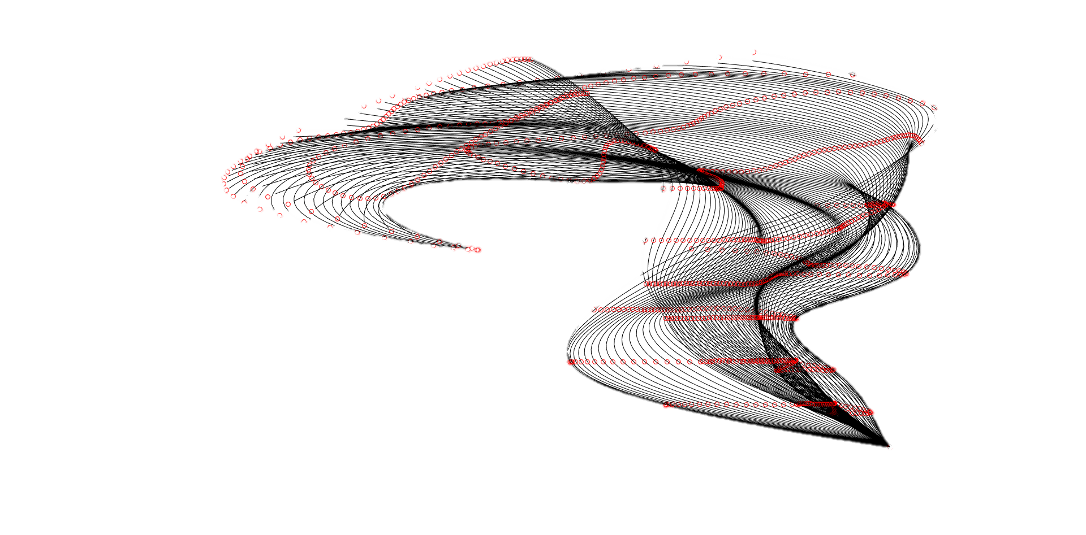
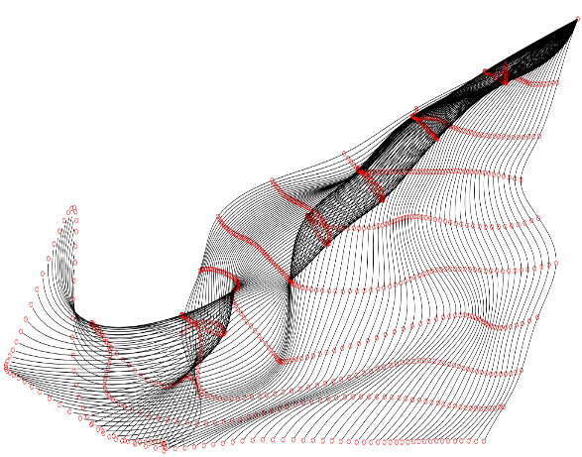
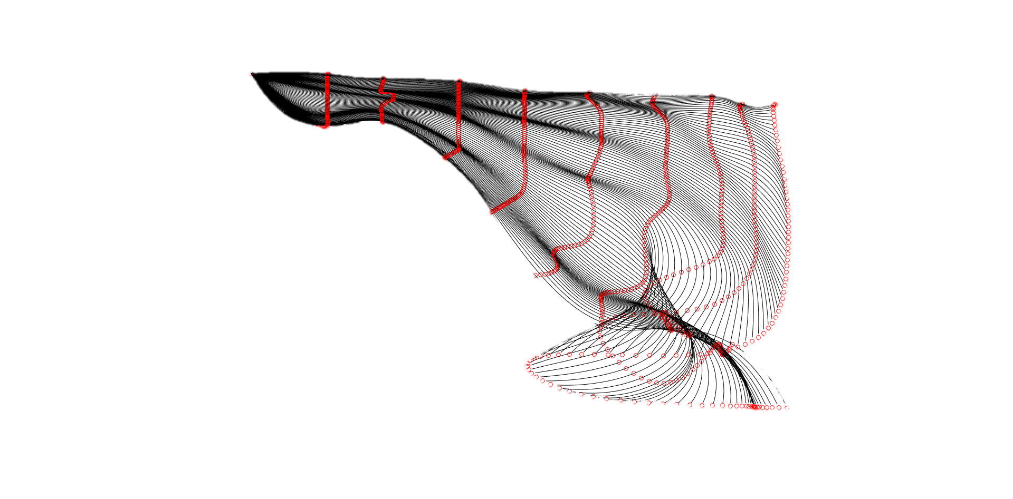
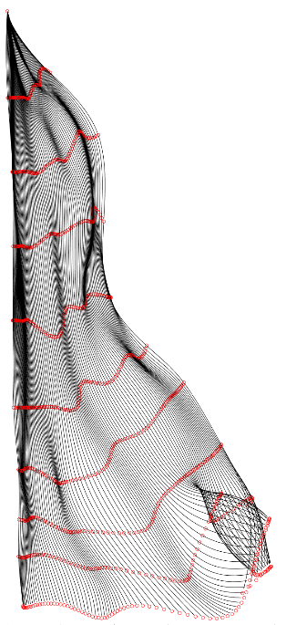
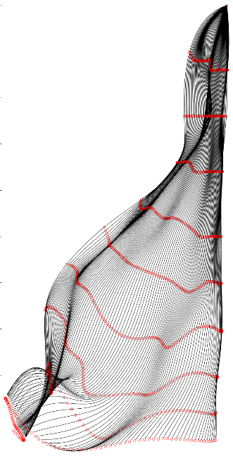
Combining interpolations: across time and space
TOP LEFT ARM
TOP RIGHT ARM
TOP MIDDLE ARM
BOTTOM
LEFT ARM
Interpolating along the length of each arm and across all intermediate
time values.
RIGHT
ARM
LEFT ARM
BOTTOM
MIDDLE ARM
BOTTOM RIGHT ARM

Slide 13
To run the code…
First, run 8 codes to import manual data
Gives 8 3D arrays (31x10x3):
Run: get_armdescription_positions.m for each arm
(get_topmiddlarm…, get_bottomiddlarm…, etc.)
Next, run 8 interpolation codes to obtain arrays for 332 time steps:
Run: run_armdescription.m for each arm
(run_topmiddlarm, run_bottomiddlarm, etc.)
Save arrays:
Run: save_arm_data.m
Use arrays to plot octopus as a function of time:
Run: RUN_OCTOPUS.m

Slide 15
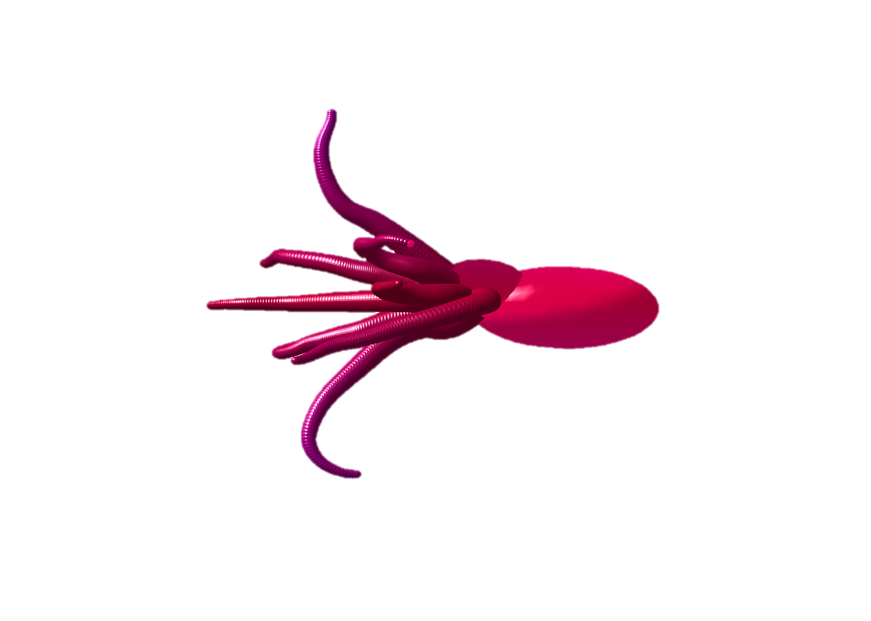
Questions

