Slide 1
Diffusion Limited Aggregation in 3D
David Adams

Slide 2
Background
Witten-Sander process
Seed particle at center of space
Random walk particles until bond
Forms self-similar fractals

Slide 3
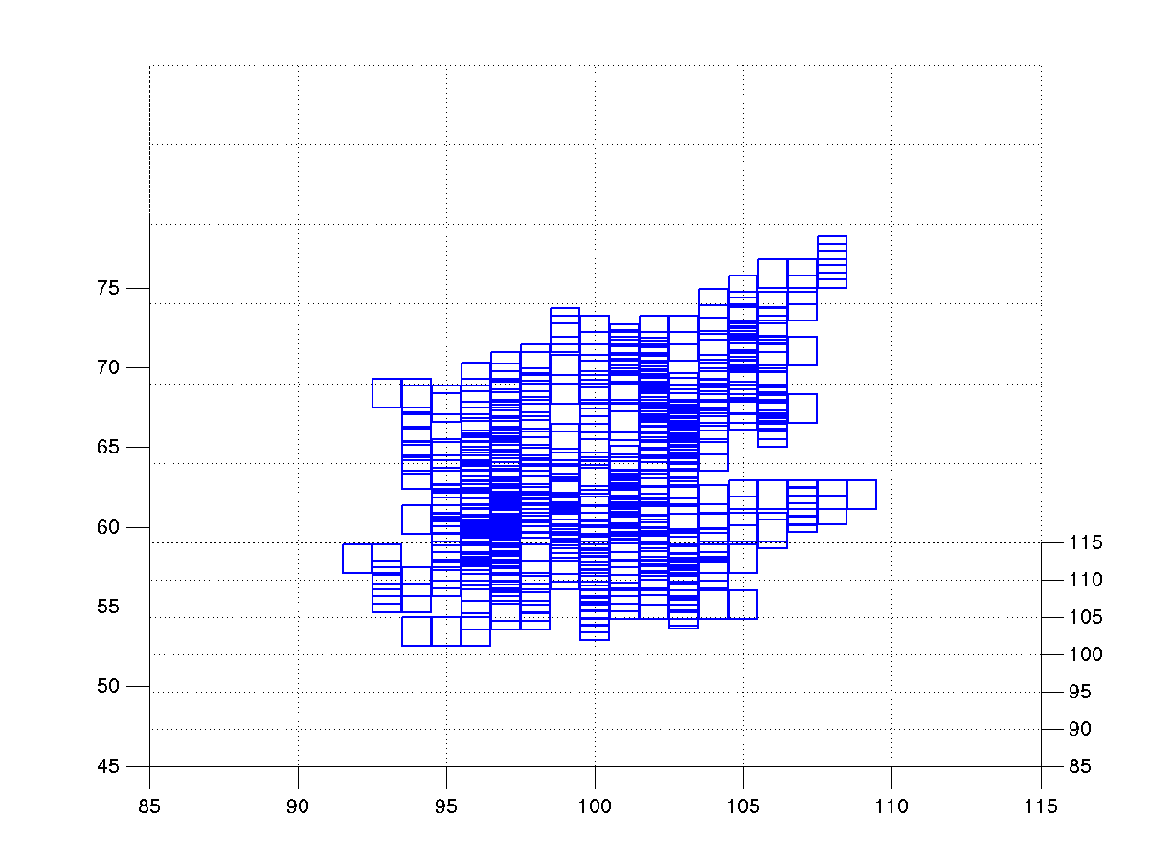
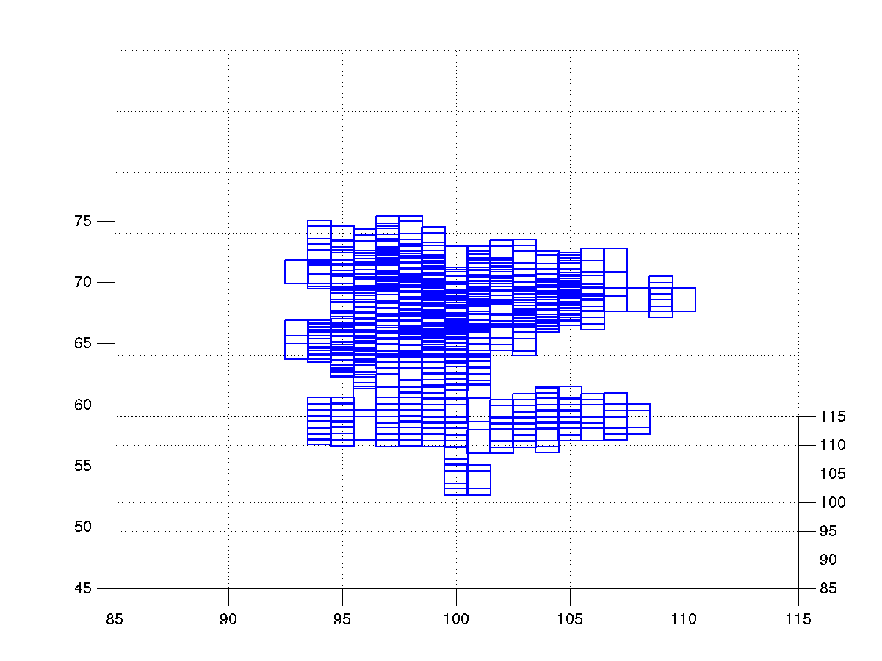
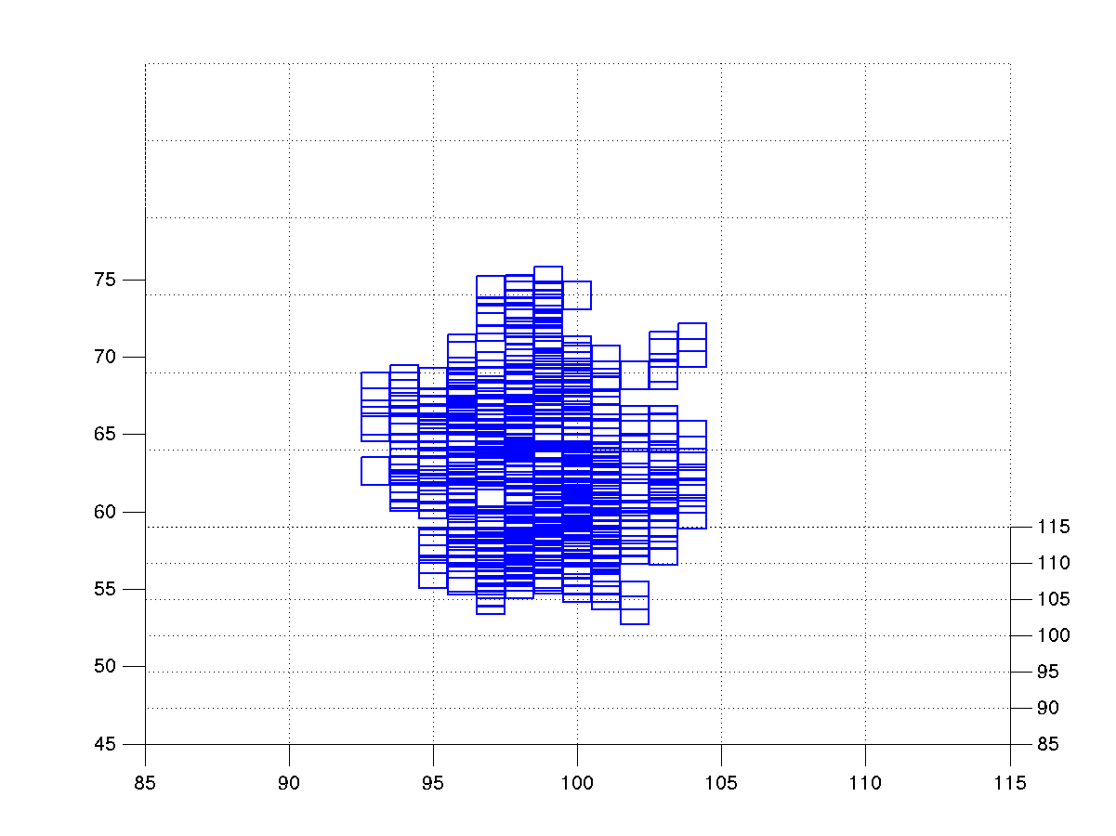
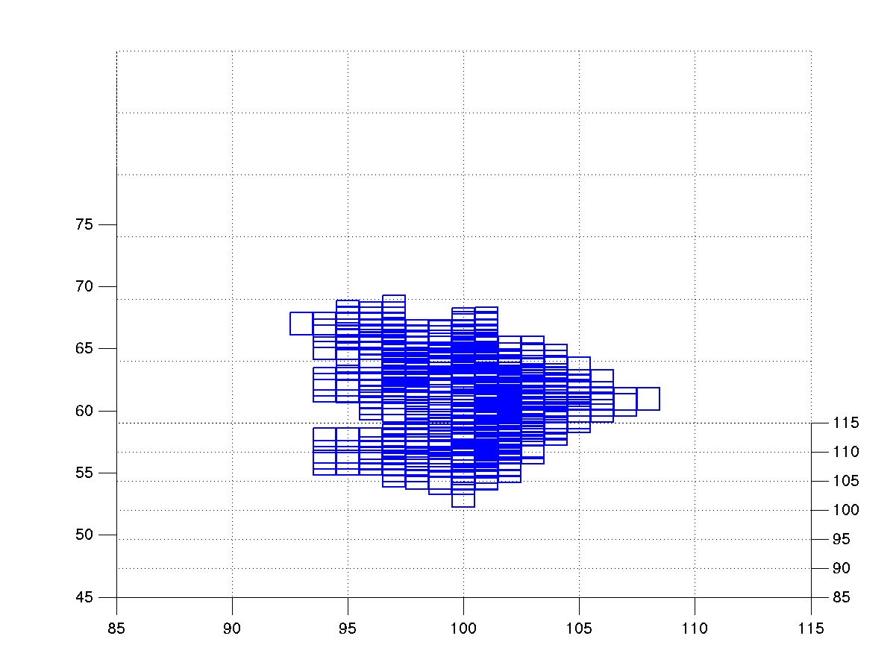




p = 1 p = .5 p = .25
p = .1

