Slide 1
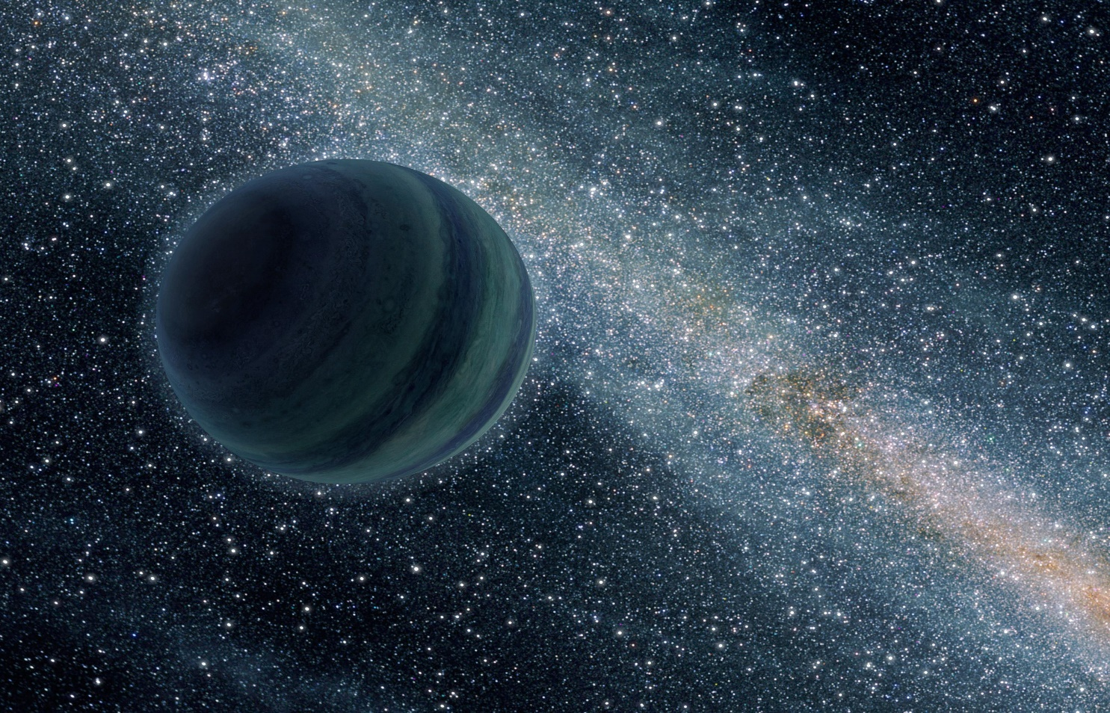
Rogue Exosolar Planets
Phillip Sells
EPS 109
December 2nd, 2014

Slide 2
Observational Data
WISE 0855–0714, Closest free-floating exosolar object
Sub-Brown Dwarf (low mass brown dwarf / high mass planet).
Distance measured at 7.5 +/- 0.3 light years (Pluto is 320 light minutes).
WISE 1049-5319, Binary brown dwarf system
Distance measured at 6.6 +/- 0.06 light years

Slide 3
MATLAB Simulation
Inner Solar System + Jupiter
4th order Runge-Kutta method for ODE calculation
Two large mass exosolar objects introduced to system (non binary system)
Exosolar objects scaled to DENIS-P J082303.1-491201 b (~30 Jupiter masses).

Slide 7
Running the simulation:
Modify masses & initial angle of objects in lines 5-20 of rogueplanet.m
All current data is in cgs units, and all initial angles approximate the actual positions of the planets as of December 2014.
Place rogueplanet.m, and rogueplanet_ode.m in your working directory
Run by typing: rogueplanet

