Slide 1
Ocean Wave Interactions with Land Masses
Tony Wu

Slide 2
Description
Using the shallow water equations from lab 10
Modeling interactions with slopes and islands
Depending on the water’s height relative to the island, the waves either cover the island or reflect
When water hits the slope, it loses kinetic energy
Modified original water equations to mimic this behavior

Slide 3
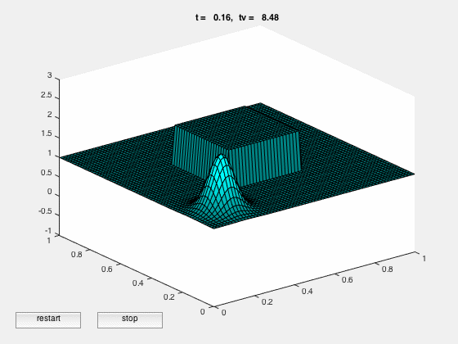
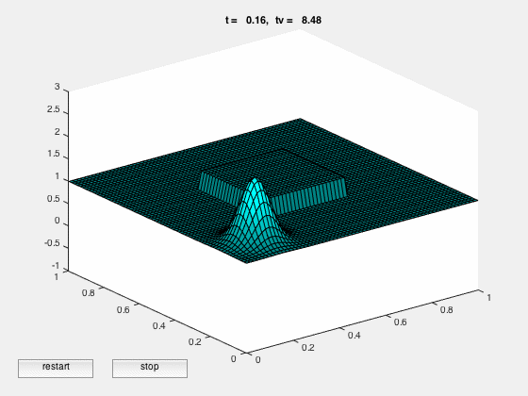
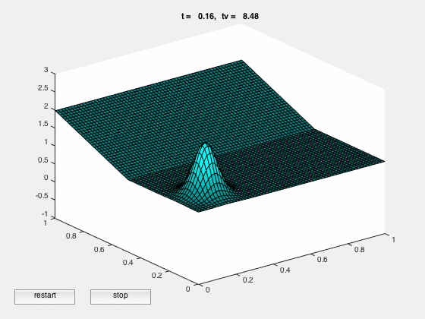



Results

Slide 4
How to run my code
I put TODO tags next to everything that can be changed by the user (ctrl-F for them)
Can either set the terrain to a slope or island
Can either set the island to tall or short
Can change the gif name
Just run the waterwave03.m file

