Slide 1
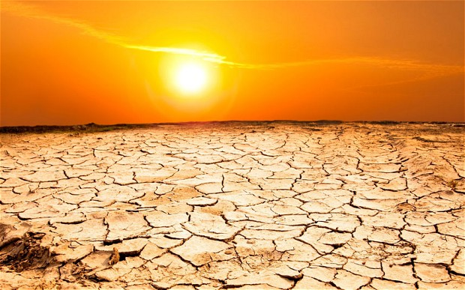
Great Plains Drought
EPS109 Final Project
Professor Burkhard
By: Sol Kim

Slide 2
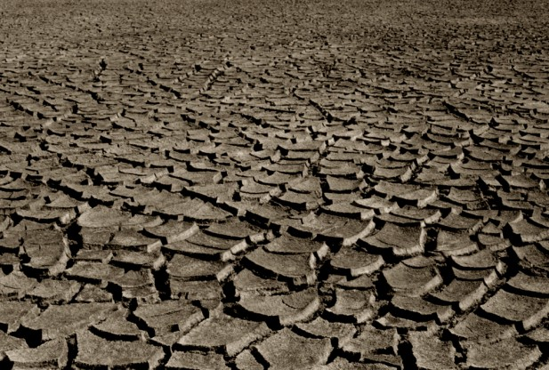
Drought Background
Data: NCEP/NCAR Reanalysis 1 Data
Variables: v-wind (m/s) at 700 mb and geopotential height (m) at 500 mb
These are the two main factors underlying the Great Plains drought of 2012
High geopotential height anomaly and shifted westward from mean conditions
Weakened or reversed meridional winds in the Gulf Coast. Typically strong Northward winds.

Slide 3
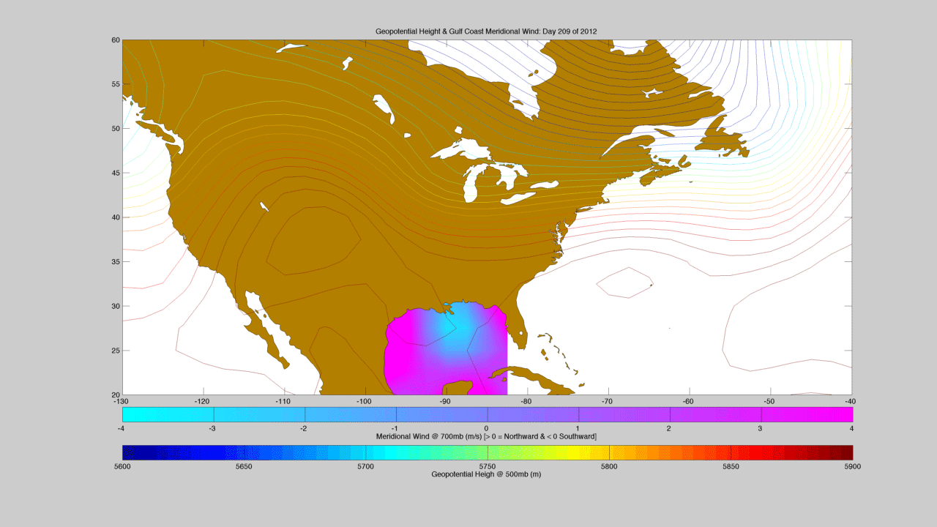


Slide 4
How to run the code
Add these files/directories to your path
  fc (freeze color function for mapping 2 variables)
  cb (color bar freeze function)
  export_fig (saveas would not export png correctly)
  mexcdf (loads and extracts nc files)
  vwind.nc & hgt.nc (raw data in nc format)
  MATLAB must have mapping toolbox to generate U.S. landmass
Will generate a figure that shows geopotential height over the U.S. and meridional winds in the Gulf Coast region

