Slide 1
Diffusion of Gas Particles
JeremiaH harris

Slide 2
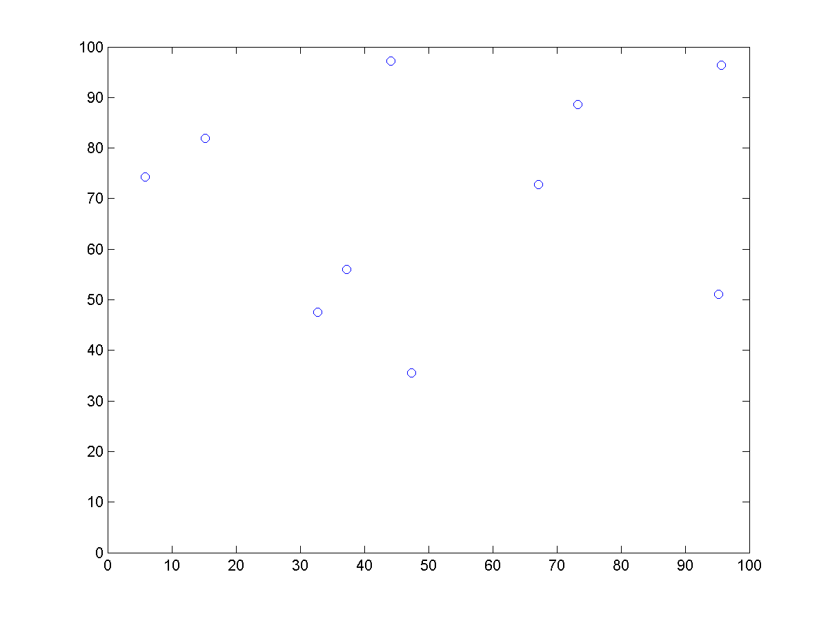
Methodology and Background
3 Main Simulations
Basic Simulation: gas particles within a closed container
Random initial positions and velocity
Collisions between particles – conservation of momentum (elastic collisions)
Boundary conditions
Wall with Hole:
Boundary conditions must now include center wall
Varying Temperature:
Kinetic Theory of Gases: $\frac{1}{2}$ mv² = $\frac{3}{2}$ kT, k = Boltzmann constant
As temperature increases by scaling factor n, velocity of particles increases by factor of $\sqrt{n}$

Slide 3
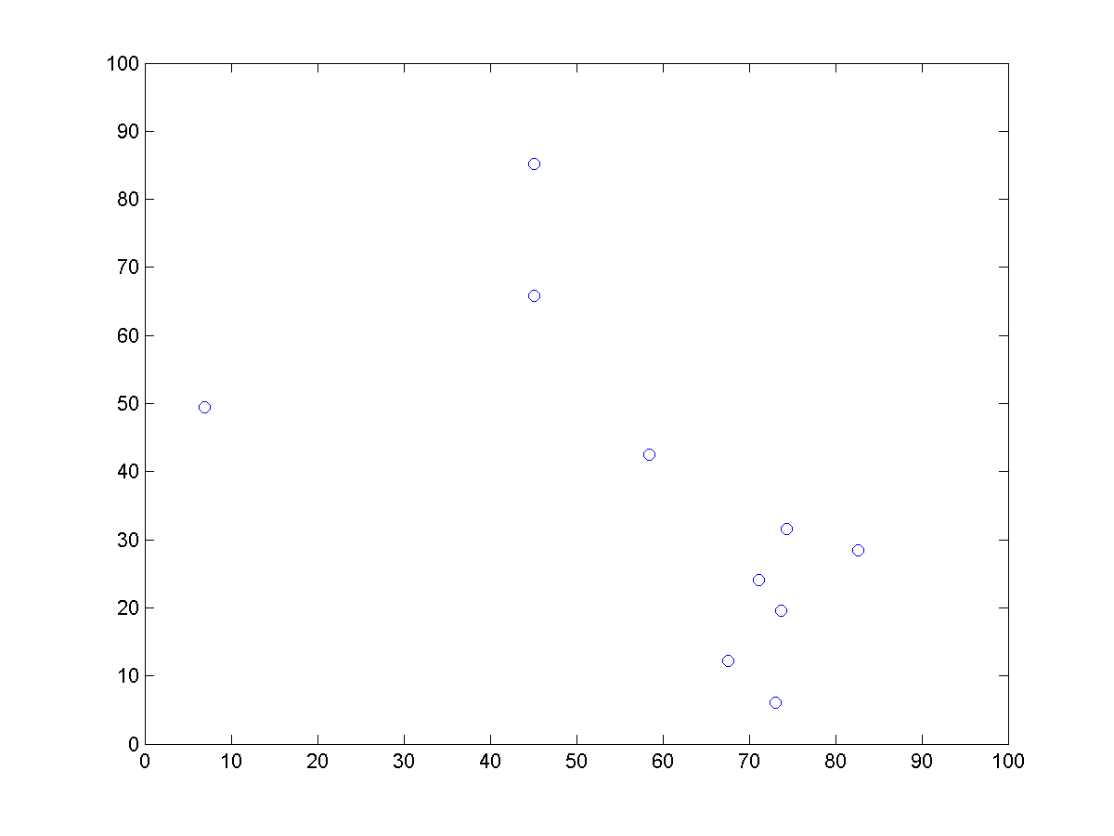
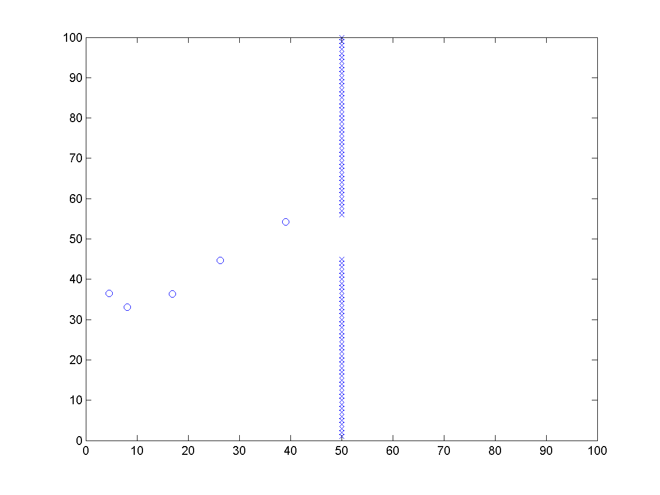
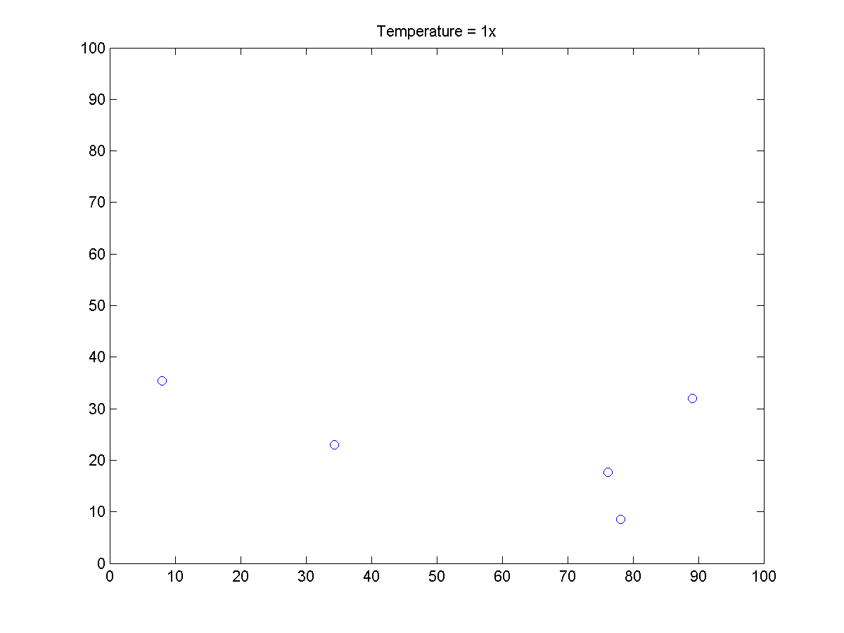
gas_wall.m
gas.m
gas_temp.m

