Slide 1
Maze Solving
Nicholas Pena

Slide 2
Background
Take an image of a maze and convert to a matrix
  Limitation on the appearance of the maze
Use of Brownian motion inefficient to solve mazes
  A second matrix as a copy of the maze that will store where the particle has been and walls
Again unlikely to solve maze and very slow
  Use motion to walk wall to wall, choosing the greatest distance
  Instead of just moving to where the particle hasn’t been, if it gets stuck then override the remembered spots

Slide 3
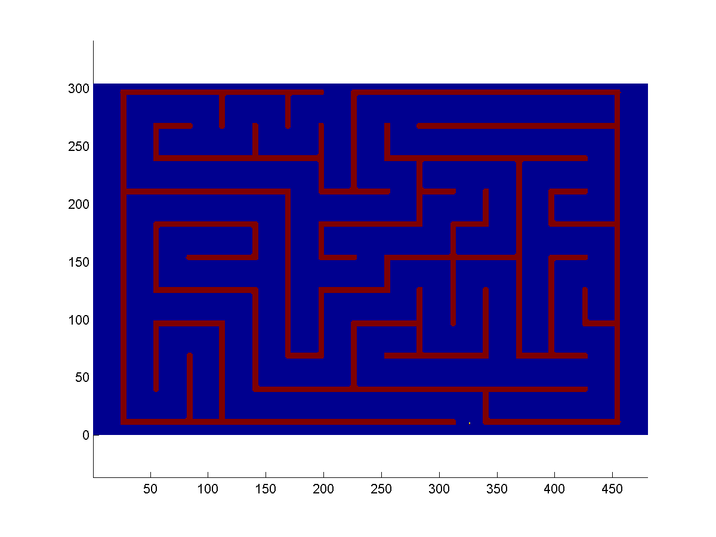

Brownian Motion with Memory
Run mem_maze.m

Slide 4
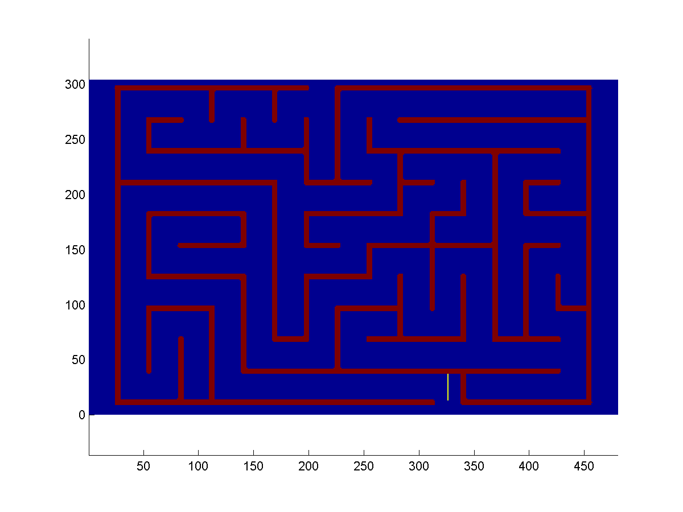

Wall to Wall Movement
Run Wall_maze.m

Slide 5
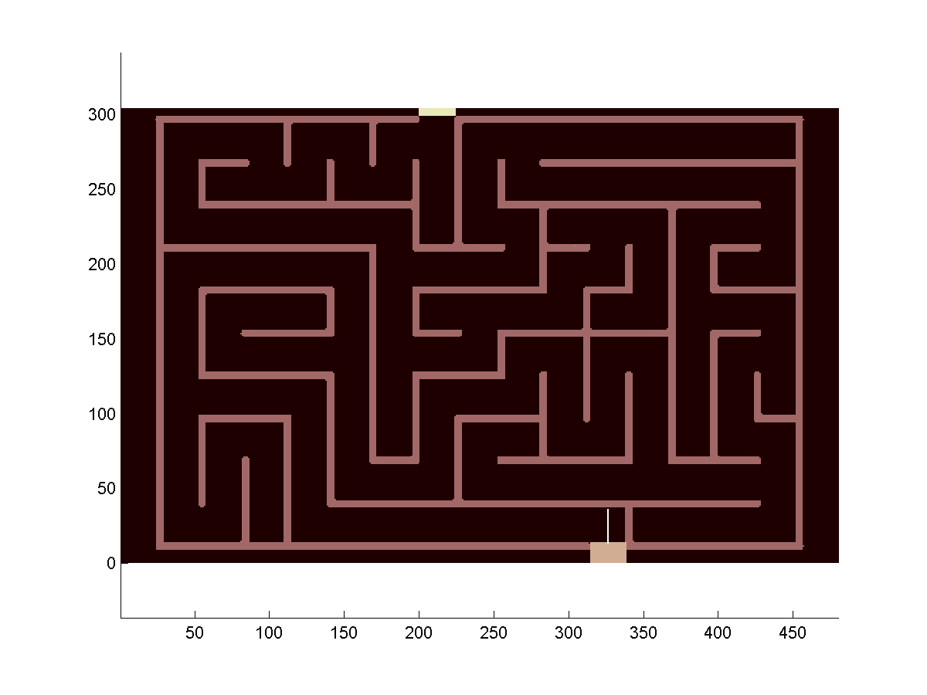

The Memory
Run Wall_maze.m plotting B instead of A

