Slide 1
Filtering of MicroCT Images with Matlab
Ruxun Zhang
EPS 109

Slide 2
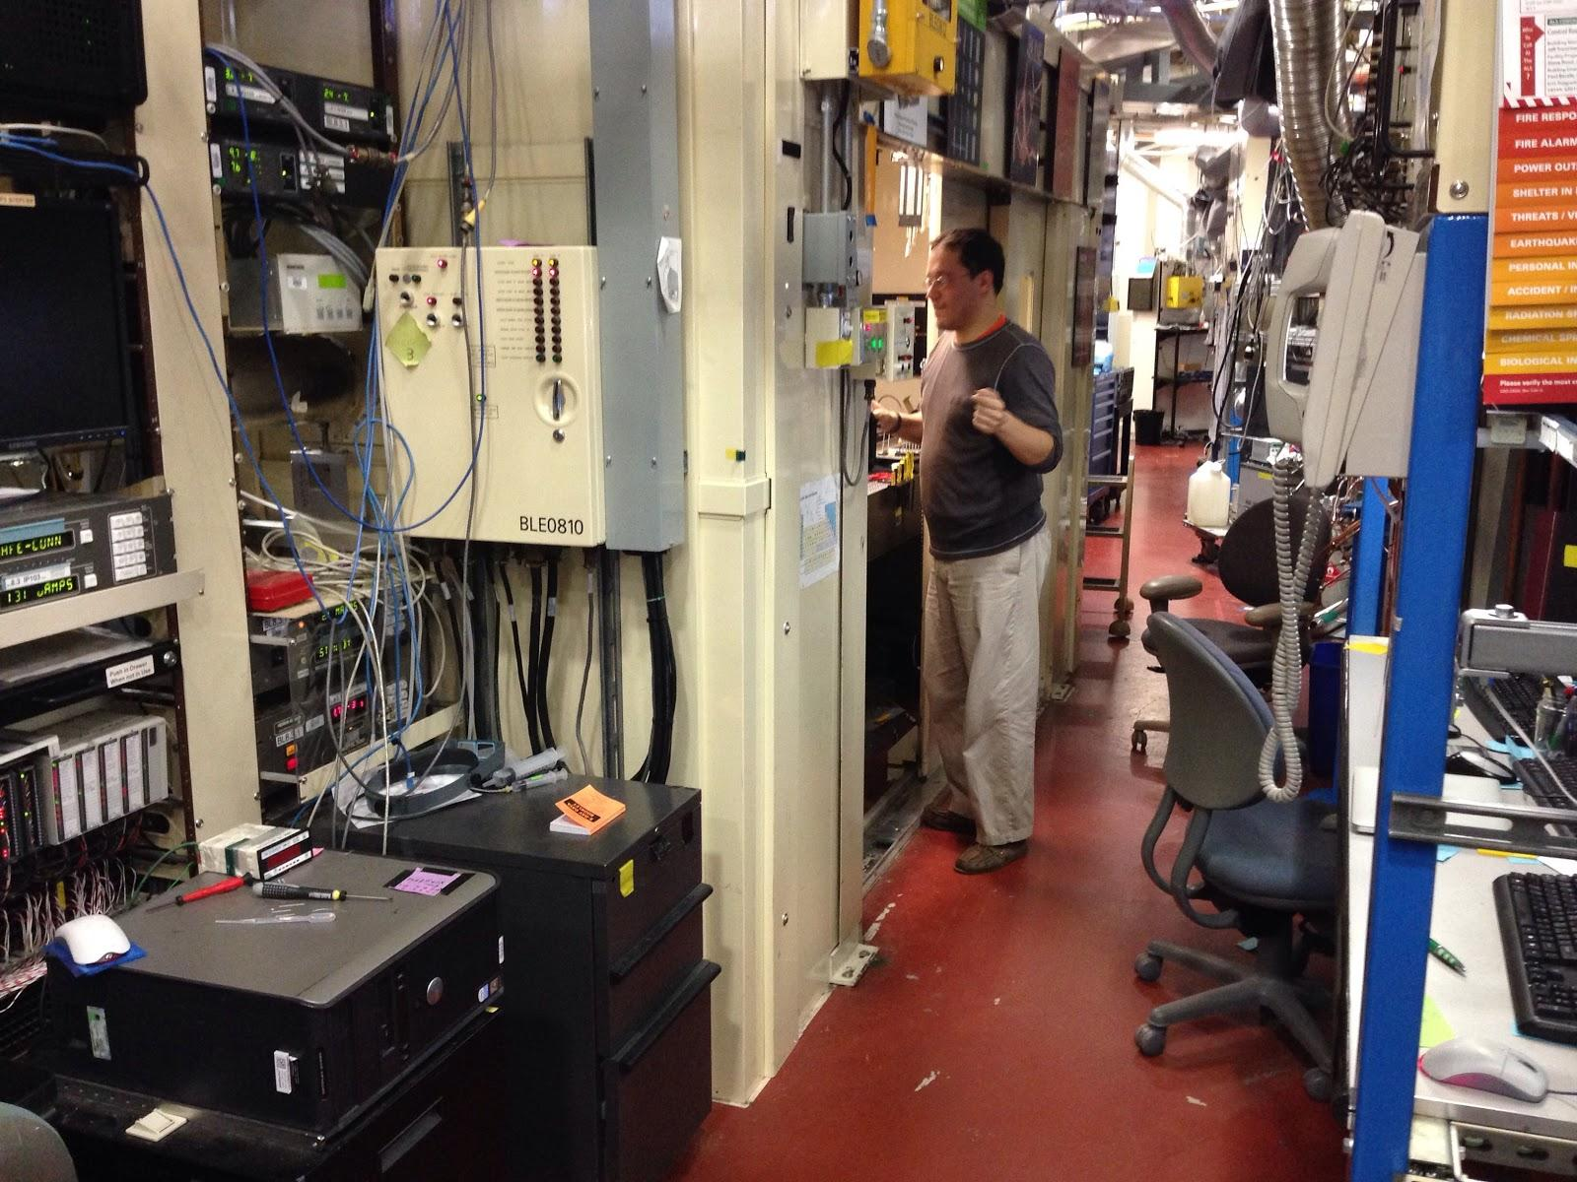
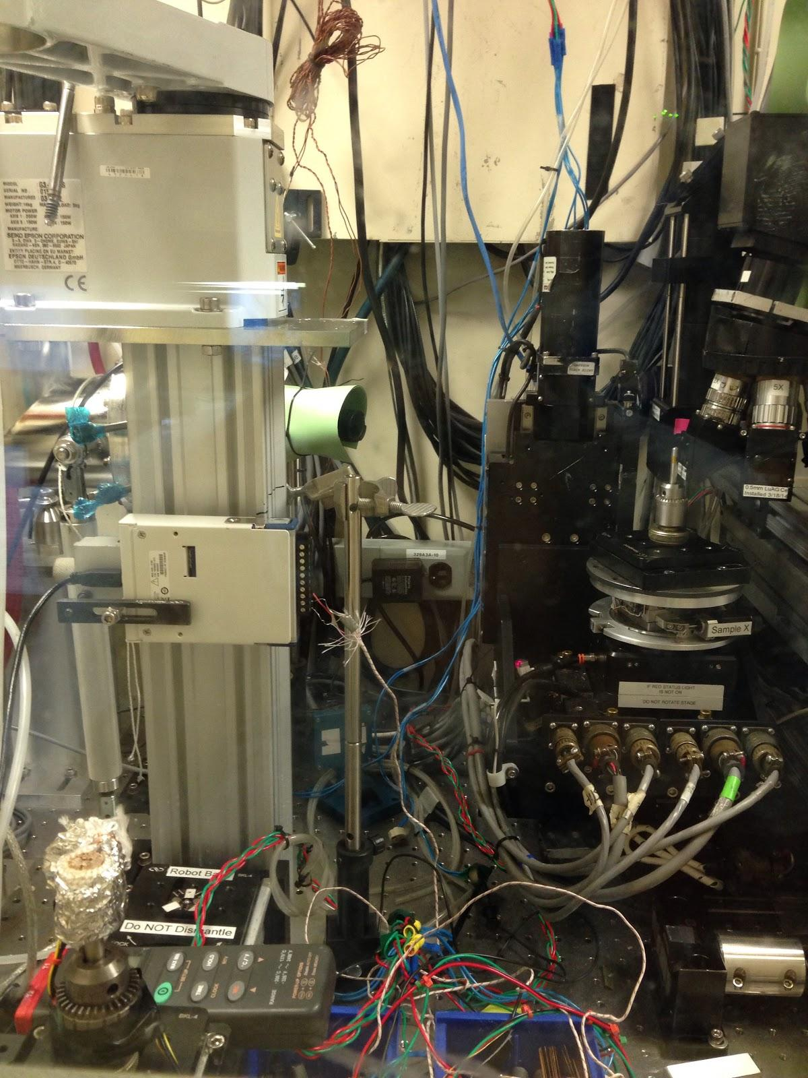
Background
Micro CT
Image Radon Transform (sinogram) Filtering
Radon Transform

Slide 3
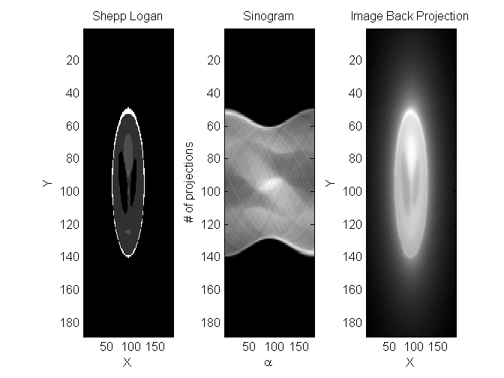
Running a Filter
use main file CTRecon.m
Creates the original image (can be any type of image file)
generates a Sinogram and does a back projection of the image
more filters can be added
SinoImg- creating sinogram
BackProj- Backprojection

Slide 4
Citations
http://upload.wikimedia.org/math/1/1/7/11757bdf9aa8cc03a8e6eeb52691c58a.png
http://upload.wikimedia.org/math/e/e/8/ee83decef5edab5c35c440bde60b3708.png
The Radon and X-Ray Transforms
Research Training Group
Inverse Problems and Partial DiÆerential Equations
Department of Mathematics, University of Washington
NSF supported Summer School 2012
Peter Kuchment and G¨unther Uhlmann
June 27, 2012

