Slide 1
Sounding Like an Ending: What Makes a Tonic?
Jon Weiner
EPS 109
Fall 2014

Slide 2
What Makes a Tonic?
Background
Tonic: Pitch a sequence resolves to
Scales are named after tonics
Using specific scale, should get that as tonic
This doesn’t always happen. Why?

Slide 3
What Makes a Tonic?
Methodology
Random selection of 12 values
To ensure randomness, use rng (‘shuffle’) before running for first time to reset random number generator
Each value corresponds to a certain pitch
Plot values for sequence
To create audio
Take plot and put into music writing software
For my presentation I used Sibelius, but can also use free software such as MuseScore or Noteflight
Export and convert to mp3

Slide 4
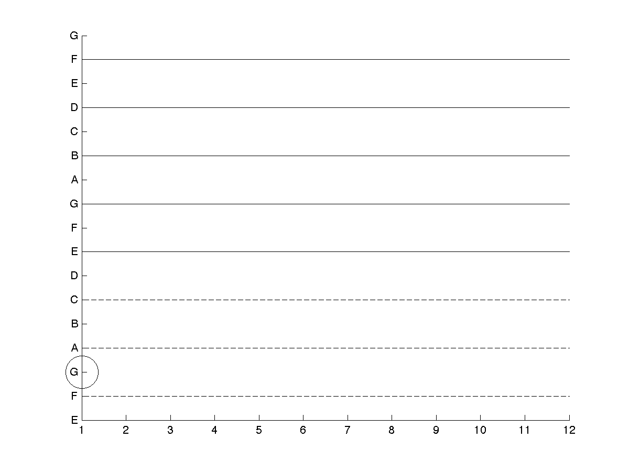

Slide 5
