Slide 1
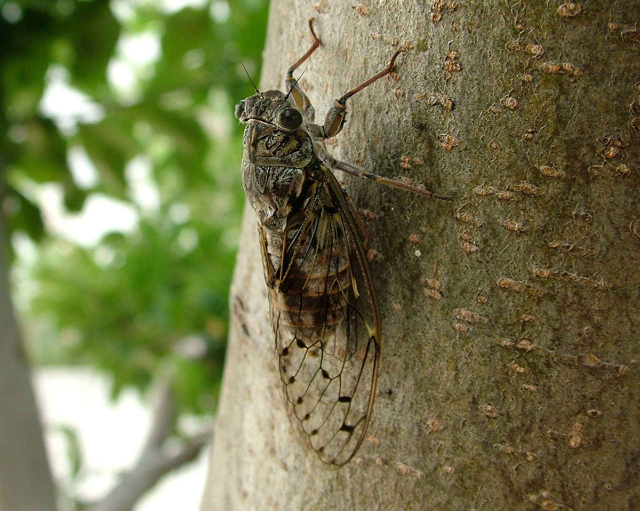
Cicada Survival Simulation
Derek Jung

Slide 2
Life of Cicadas
Cicadas spend years underground before coming out to surface in order to mate and lay eggs.
Primary number of years of hiding.
Simulating a scenario where cicadas are trying to get out of the ground to the surface in order to start mating

Slide 3
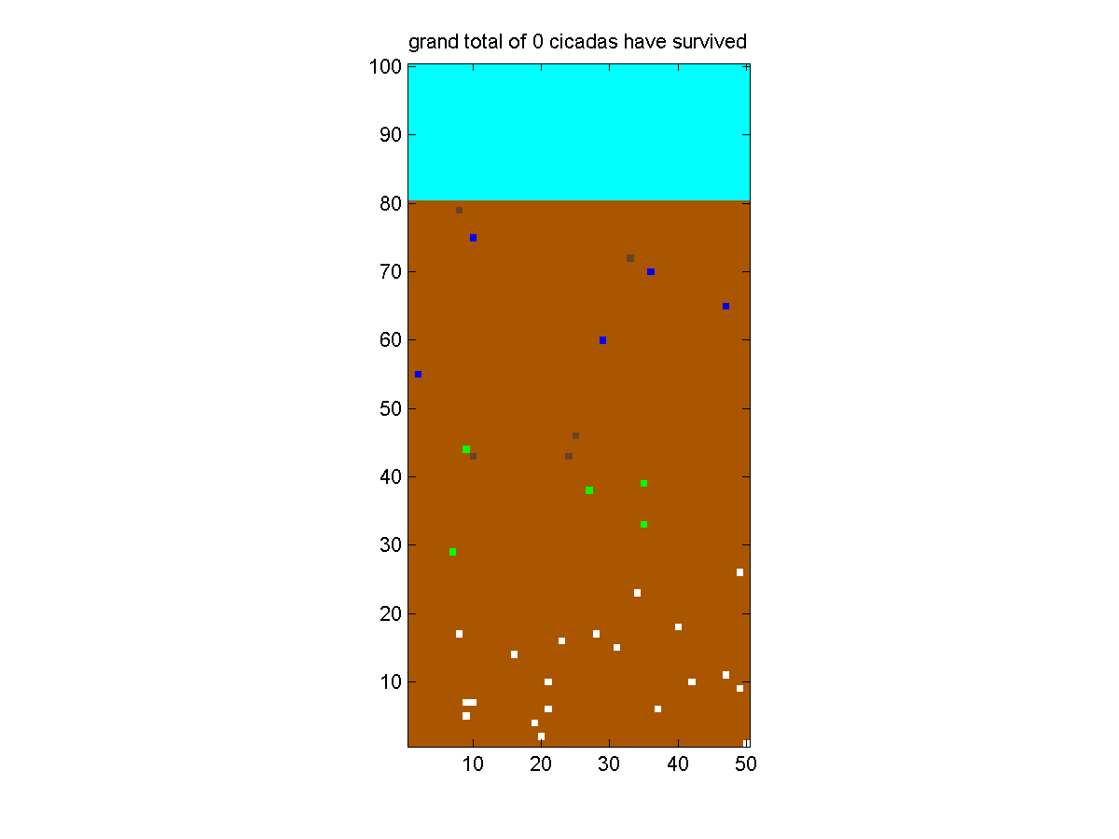
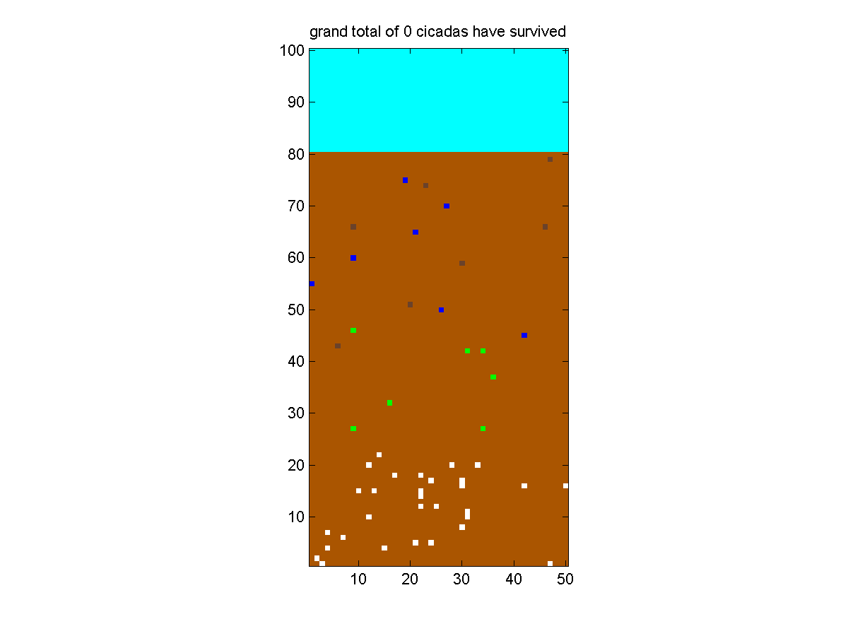
Methods
Used matrix. Random walking.
Cicadas: Random walking with higher chance to move up (U:50%|L:20%|R:20%|D=10%)
Pred type 1 : random walking (same chance in all directions)
Pred type 2 : random horizontal motion
Pred type 3 : Stays still
When cicada comes to the tile next to predator, it gets eaten. (for pred type 3, cicada dies even if it comes to the tile diagonal to it)
Count number of cicadas that survive and surface!
Color coding using colormap: White=Cicada | Green: Pred type 1 | Blue: Pred type 2 | Dark Brown : Pred type 3 | Brown: Soil | Skyblue : air
Run code by running Cicada.m on matlab
20cicadas
15 preds (5 each.)
30cicadas
15 preds (5 each.)
30cicadas
21 preds (7 each.)

