Slide 1
Matlab Terrain Generation
Atsu Kakitani

Slide 2
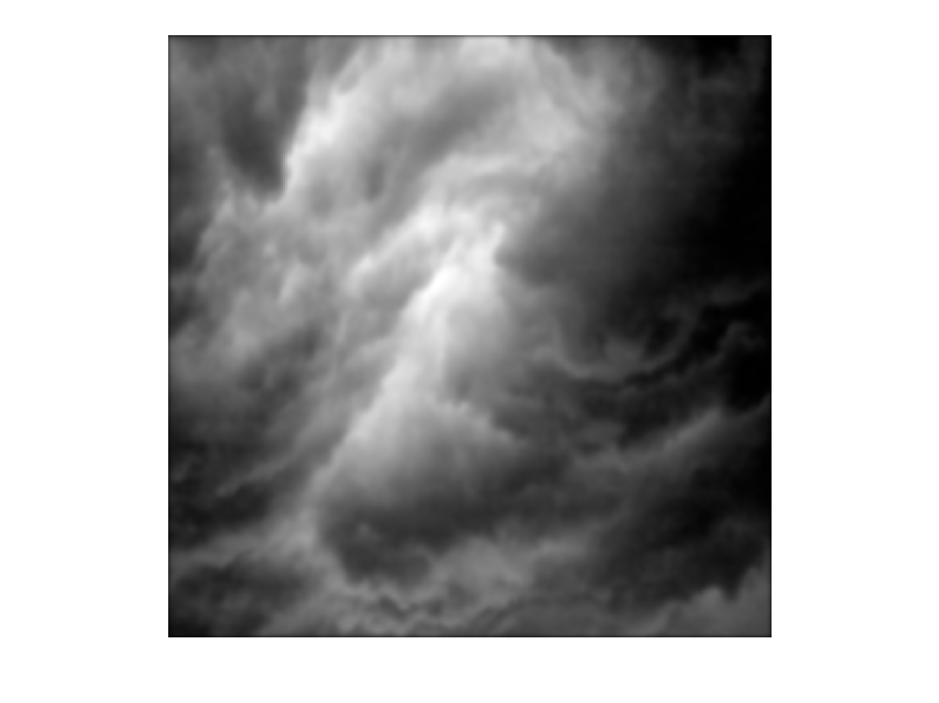
Process
Generate heightmap → Gaussian smoothing (optional) → Render as terrain
Midpoint displacement
Recursive algorithm
Square step: take avg of 4 corners + random offset
Diamond step: take avg of 4 corners + random offset
Random walk
We leave a “trail” for every position we visit
Each time we visit a (x, y), we increment the count at (x, y)
Using images
Take some image and just use a grayscale version as the heightmap
Gaussian smoothing
Create multiple copies of the heightmap and apply the filter – filter radius is increased from one image to the next
Combine the images back together (sum the matricies)
To run, just call main(<terrain_fn>)
Valid <terrain_fn> values listed in main.m
https://github.com/akakitani/matlab-terrain/

Slide 3
Midpoint Displacement

Slide 4
Random Walk

Slide 5
Using Images

