Slide 1
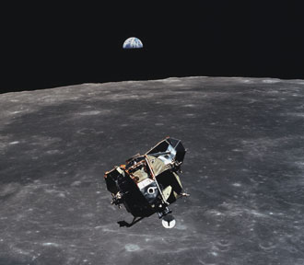
Apollo 11 Flight Path
James Hoenig

Slide 2
Apollo 11 Flight Path
1st Approximation Model of Apollo 11 Trajectory on Earth-Moon orbiting system.
Solved using Runge-Kutta & Kepler Orbital Equations.
Velocities and trajectories obtained from NASA flight log.
Basic Model, useful for calculating required course corrections than true to life flight path.
Run with apollo_11_trajectory.m

Slide 3
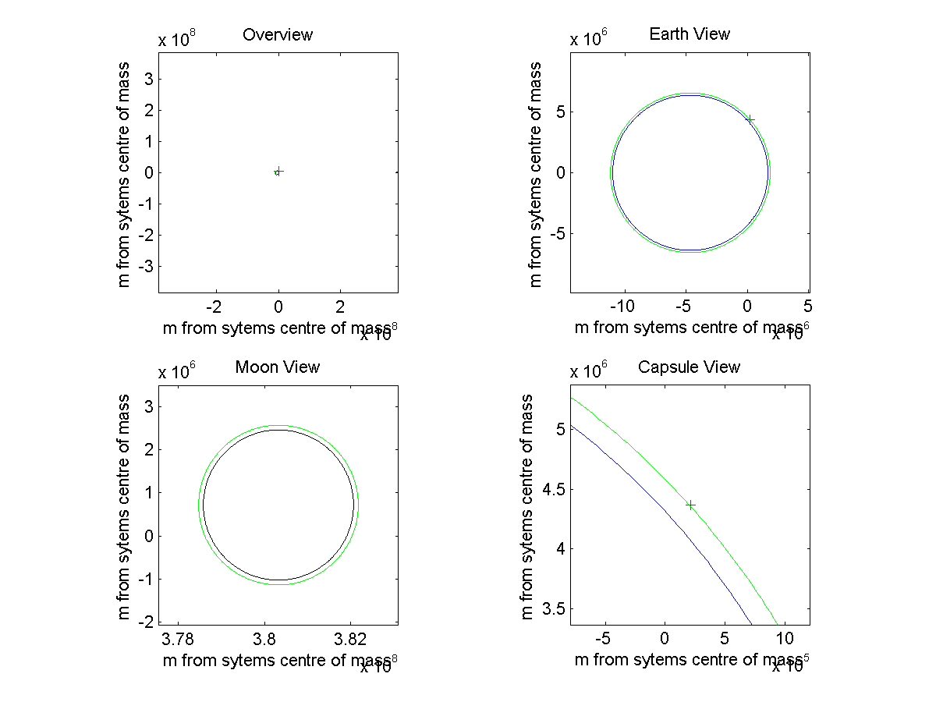
The Flight of the Eagle

