Slide 1
Gosper Curve Simulation
Leif Swenson
EPS 109 Fall 2013

Slide 2
The Gosper Curve
Space filling curve
Example of a Lindenmayer System
Axiom: A
Replacement Rules
A → A – B - - B + A + + A A + B –
B → + A – B B - - B – A + + A + B

Slide 3
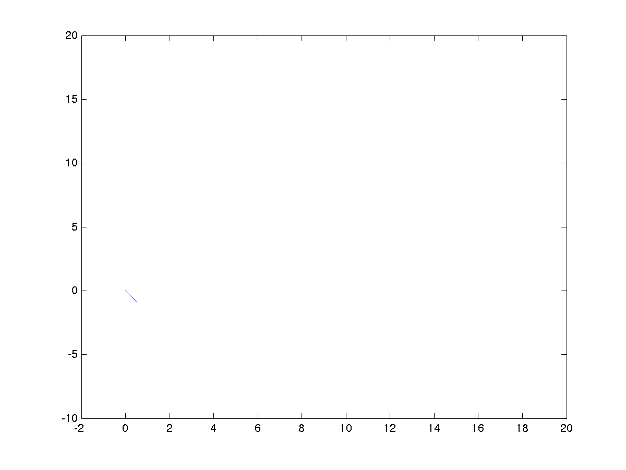

get_points([0,0],[1,0],3,-1,7^3)

Slide 4
