Slide 1
Modeling Ray Scatter and Reflection about a Point Source
By Heidi Hansen

Slide 2
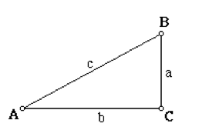
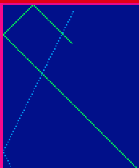
Bottom and Top Surface
tan(x) = sin(x)/cos(x) = b/a = (m₁ – m₂) / (1 + m₁*m₂)
x = theta = atand ((m₁ – m₂) / (1 + m₁*m₂))
For the top surface, m₁ = 0
For the Vertical Walls
wall length = sin(x)*ray length
theta = asind(norm(wall) / norm(ray))

Slide 3
Run my code with: RayScatterFinal.m. Be sure to have also downloaded
compute_line.m and Y_of_surface.m

Slide 4
Note: This is
with *200 in
line 12 rather
than *30.

