Slide 1
Heat Diffusion in Basaltic lavas
Andres Hernandez
EPS 109

Slide 2
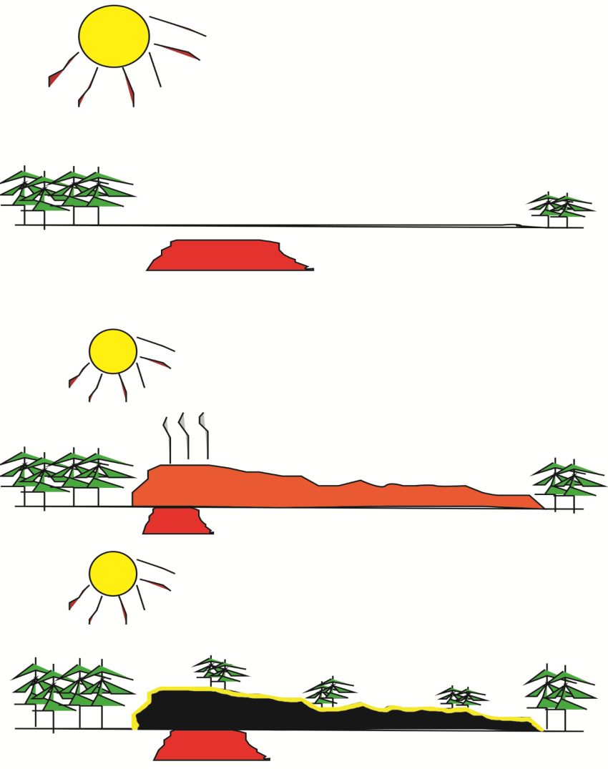
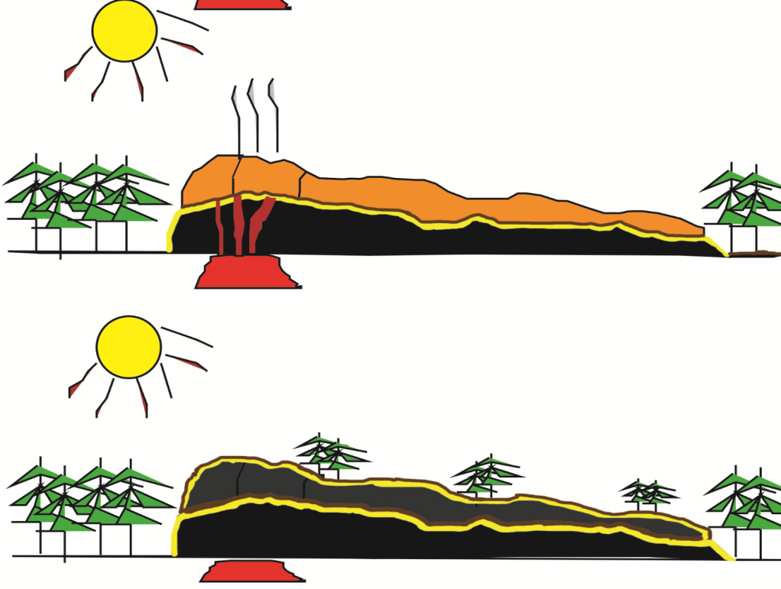
Lava emplacement and cosmogenic isotope formation
second eruption
second lava flow
surface
t=0
rising magma
t=3
lava flow
cosmogenic isotope generation (preserved sunburn)
$${CO}_{2, }{SO}_{2}$$
rest period
t=1
rest period
t=4
n, $p^{+}$,µ
cosmogenic isotope generation (preserved sunburn)
soil formation
soil formation
t=2

Slide 3
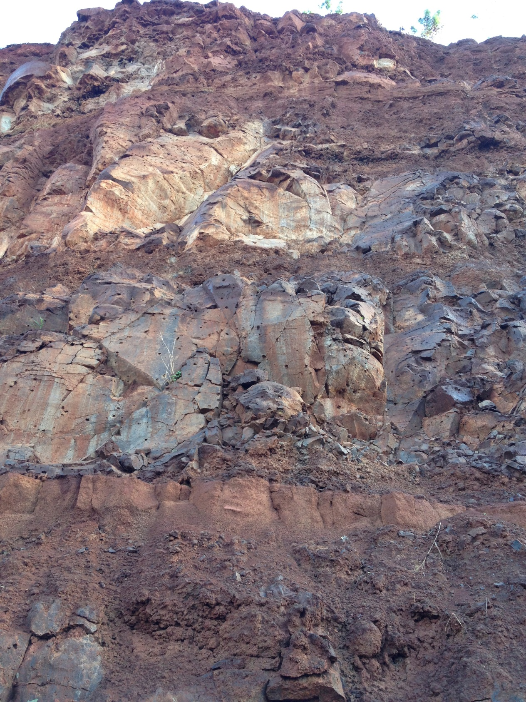
Kaua’i, Hawaii Outcrop
Photo Kōloa member lava (600,000 yrs) flow from a gravel quarry in Kaua’i, Hawaii.
Schematic diagram of exposure dating for basalts. ³He and ²¹Ne concentrations decay exponentially with depth both to a background value at ~3m. Larger concentrations reflect longer periods of exposure and the shape of the curve shows possible erosion or soil formation rates.
³He and ²¹Ne Concentration
Depth ~ 3m
Flow 2
Soil formation between eruptions
³He and ²¹Ne Concentration
Depth ~ 3m
Flow 1

Slide 4
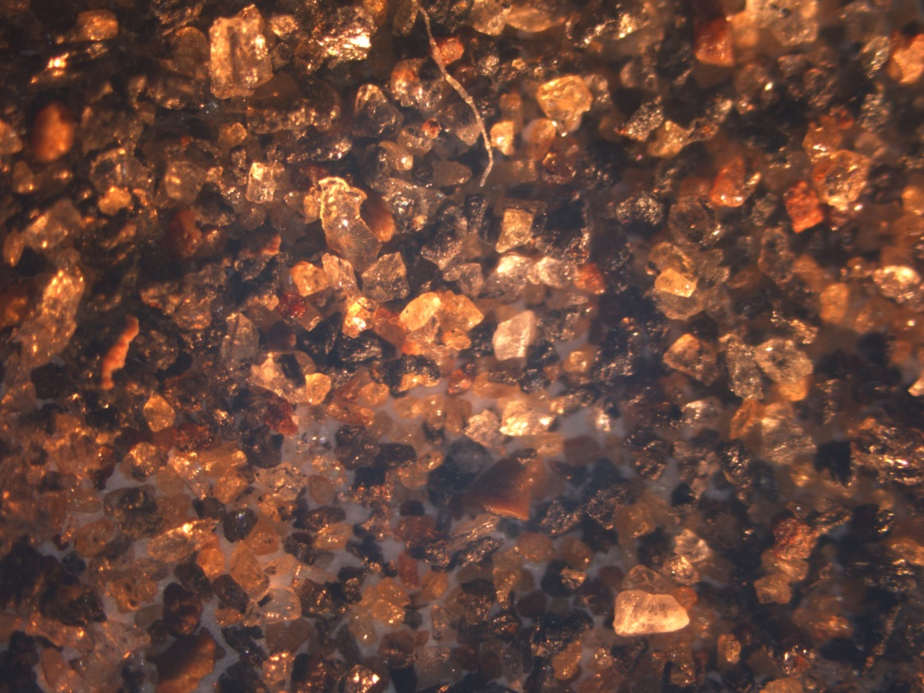
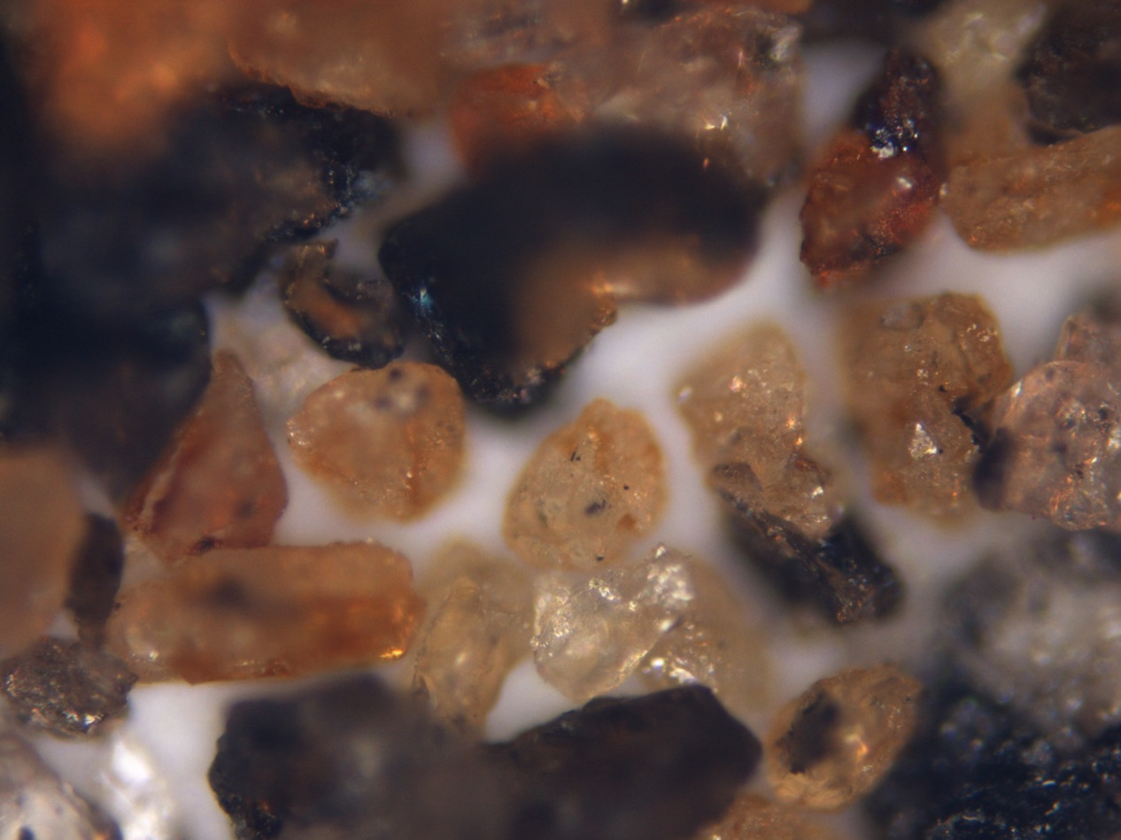
Where are the gases trapped?

Slide 5
1D Heat diffusion
Boundary Conditions
Initial temperature of the lava
T0 = 1200 C
Temperature of the air and ground
T_air =
T_ground = 25 C

Slide 6
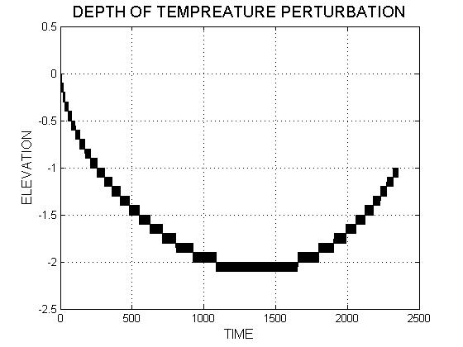

Slide 7
