Slide 1
Random Snake
Harrison Tsai

Slide 2
Random Walks, DLA
Uses probability to determine its next step
Probabilities can be manipulated to change behavior (e.g. with “sticking probability”, snake tends to go in the direction with higher probability)
Used periodic boundaries
Snake originated in arcades in the late 70s and became the standard pre-loaded game on Nokia phones in 1998
Noticeable differences: constant size and no penalty for overlap. This is to keep the movie at a constant 200 frames and preserves randomness

Slide 3
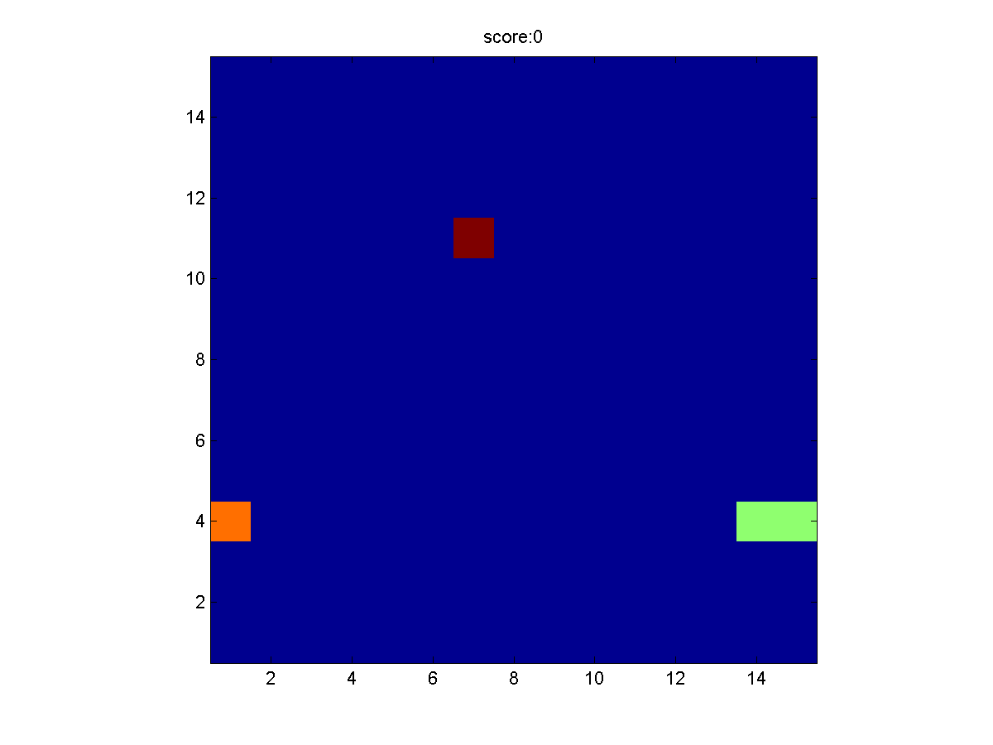
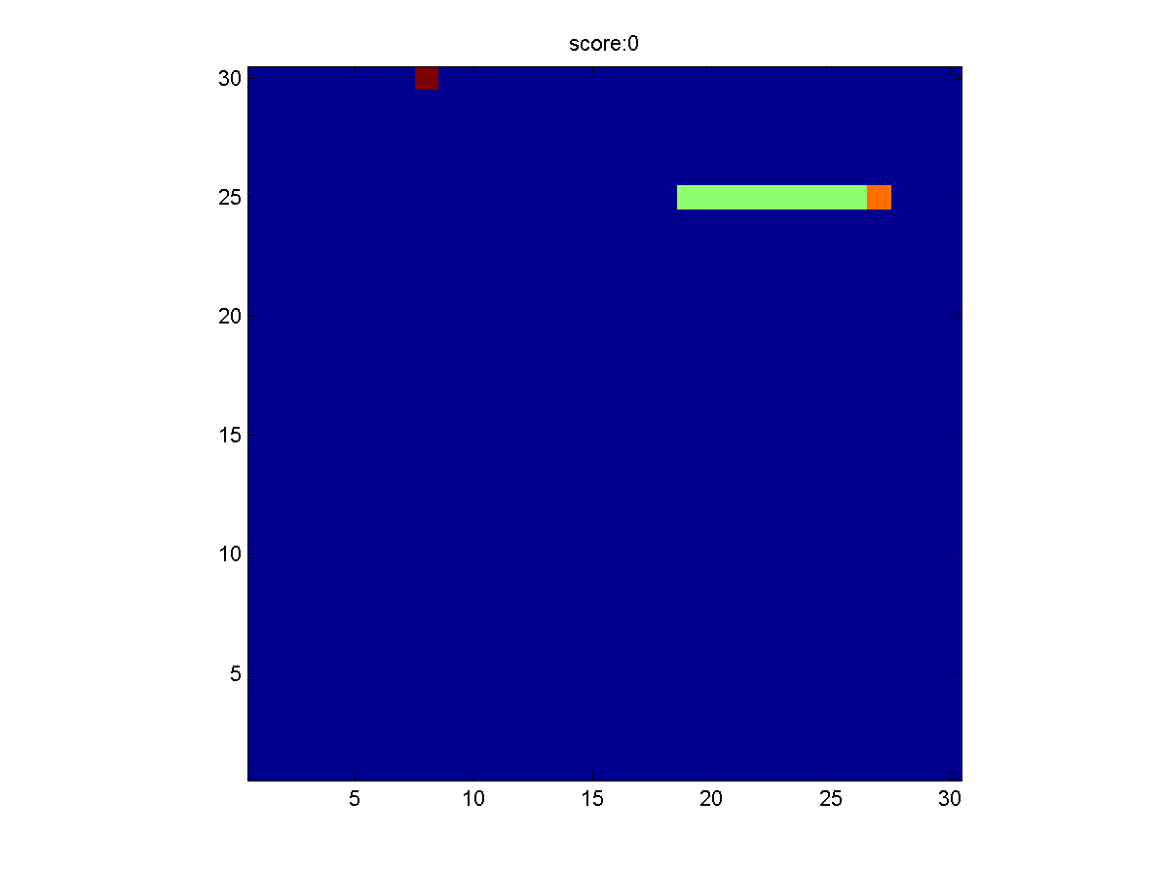
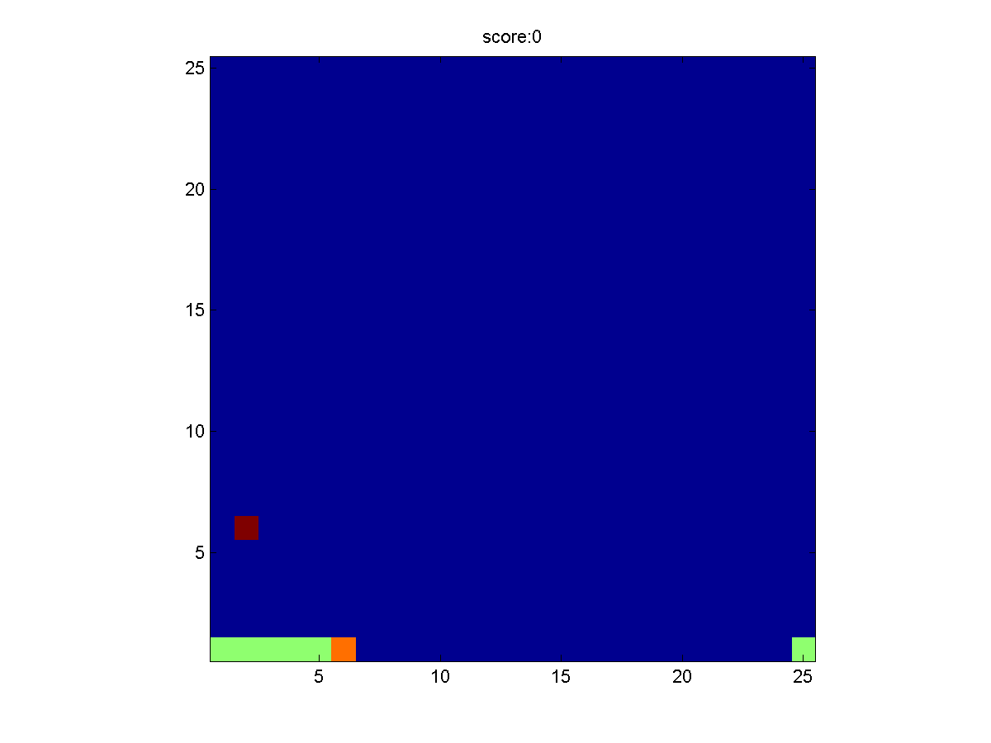
Run my code with: Matlab command line >> random_snake
random_snake.m
advance.m
place_body.m
pure_probability.m
straight_sense.m
quadrant_quest.m

