Slide 1
Expansion and Contraction on Europa
C. Culha
EPS 109
Final Presentation

Slide 2
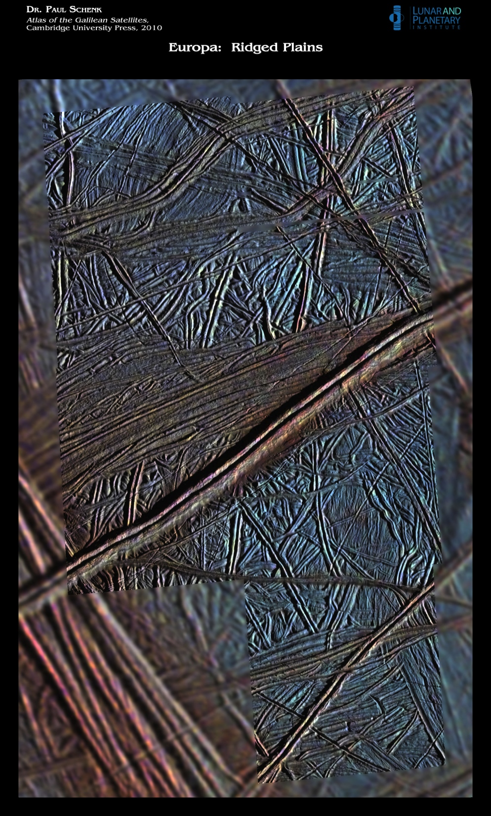
Lineament
Europa:
Bands
Width: 4-30 Km
Form through expansion
Analogous to mid-ocean ridges
Double Ridges
Narrow
Very long and abundant on surface
We know very little about these features
Culha, Hayes,Manga, Thomas
Culha, Hayes,Manga, Thomas
Culha
2/40
8/40
Notes:
*

Slide 3
Reveal tectonic motion
Europa:
Contracting and Left Lateral
Expanding and Right Lateral
Culha, Hayes,Manga, Thomas
Culha, Hayes,Manga, Thomas
Culha
2/40
8/40

Slide 4
example
Europa:
LIMITATIONS
Features crossing under younger feature
Identifying lineaments
Angle variations
RESULT
There is a relation between angle at which features intersect younger features and the amount of offset they experience
METHODS
Recreate initial surface
PDE
Geometry
Matrix Manipulations
Interactive
Run code:
ExpandContract
1 means yes
0 means no
Culha, Hayes,Manga, Thomas
Culha, Hayes,Manga, Thomas
Culha
2/40
9/40
Notes:
*

