Slide 1
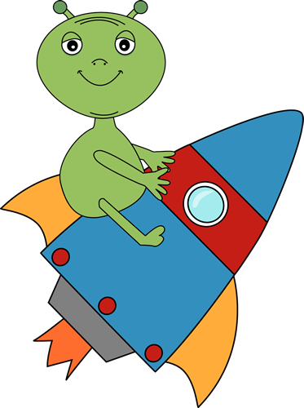
Exoplanents
Alistair Boyce, Robert Martin-Short, Nathan Nandi
James Silvey, Roland Theiss, Julien Varennes

Slide 2
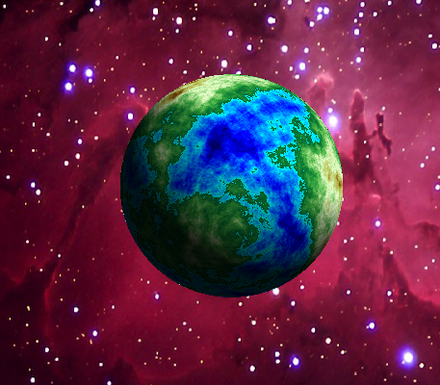
Project Goal
Early Test Image
Create realistic looking images to represent newly discovered planets.
Use MATLAB code and our knowledge of fractals to create reasonable landscapes.
Create additional layers and colormaps in order to create a wide array of exoplanets.

Slide 3
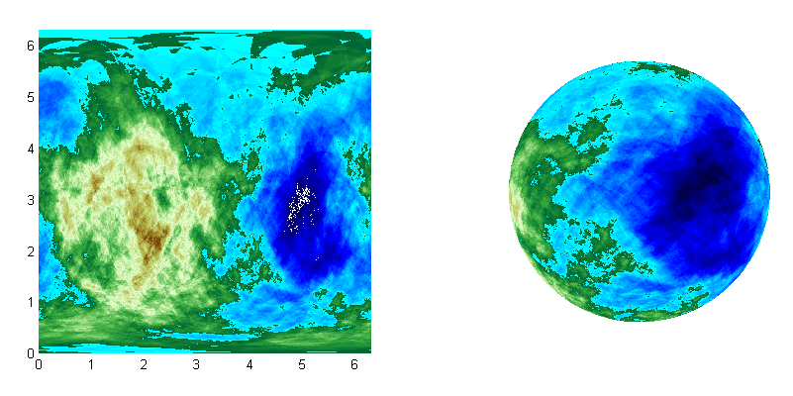
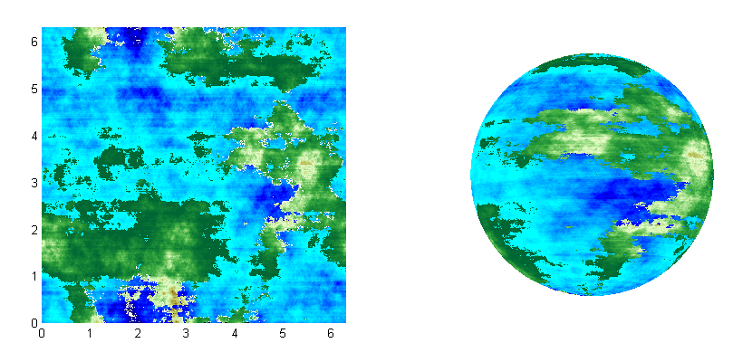
Continent generation
Solution: use Fourier transformations in order to break up the large continents and oceans our method created.
Continents were created by making random cuts on sphere.
  The elevation of the sphere was raised or lowered depending on whether it was above or below the cut.
Complication: this method tends to create large supercontinents

Slide 4
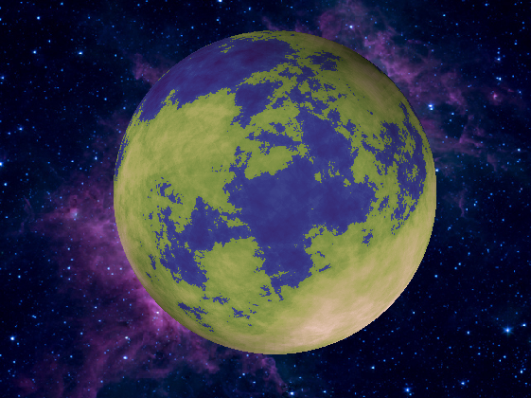
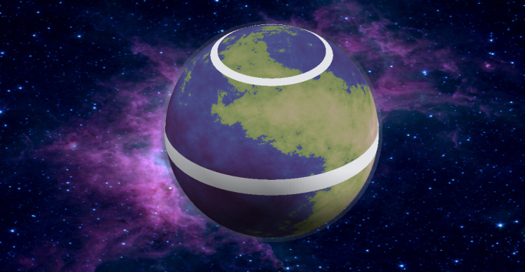
SPHERES, TRANSPARENCY
AND COLORMAPS
Colormaps obtained in .cpt format are converted into matlab colormaps by cptcmap.m
Matlab only usually allows one colormap per figure; use of freezeColors.m avoids this.
Features such as the atmosphere, clouds, storms, rings and ice caps are overlain on transparent spheres.

Slide 5
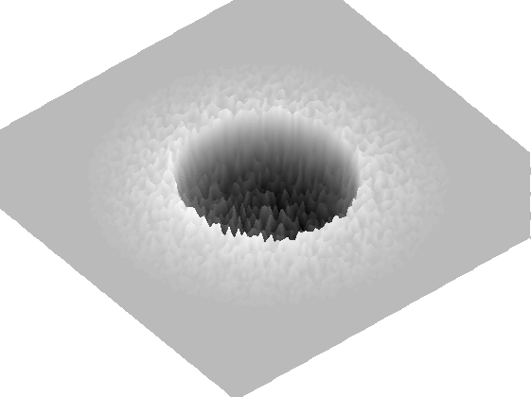
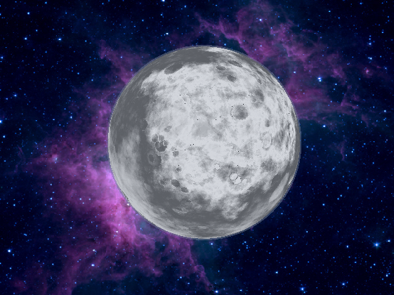
ROCKY AND ICY PLANETS
The majority of rocky exoplanets are likely to be similar to the mercury, mars or kuiper belt objects.
Craters are modeled as hemispherical holes surrounded by a rim.
The number, depth and size distribution of the craters can be altered.
Various colormaps can be used to give the impression of ice, basalt plains, oxidized surfaces etc.

Slide 6
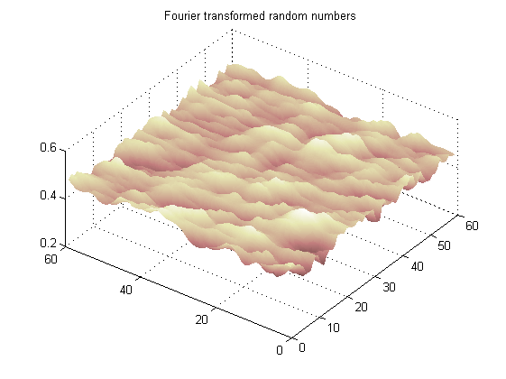
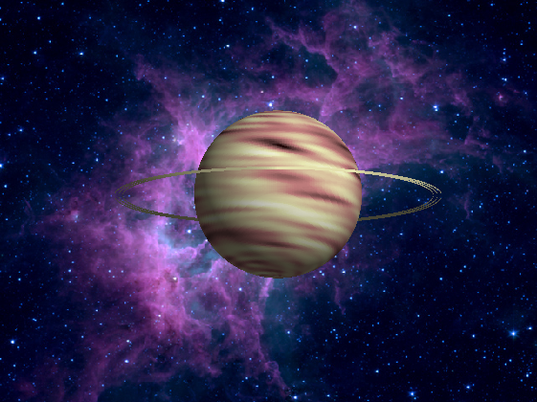
GAS GIANTS AND STORMS
The effect of rotating cloud belts is achieved by taking the Fourier transform of a matrix of random numbers, multiplying by several exponential functions and then taking the inverse.
Storm ‘spots’ are produced by creating circular depressions in the cloud matrix.
Rings are produced by coloring only the equatorial elements of three outer spheres.

Slide 7
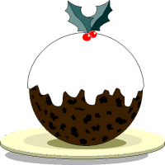
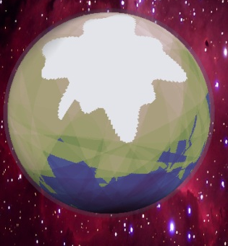
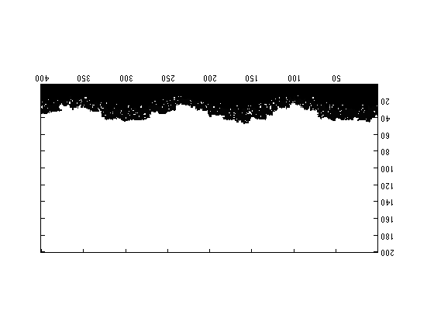
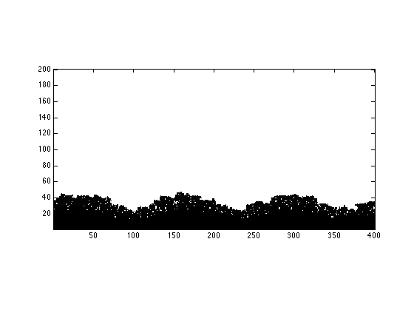
ICE CAPS
First attempt done by coloring area above a random sine curve at each pole.
Looks like a Christmas pudding, rough edges, too white, no control of shape.
Second attempt done using DLA.
Start with a sine curve.
Give the settled particles varying numbers.
Copy and rotate the matrix to get N&S ice.
Use a function to generate a number of these and save to .txt file.

Slide 8
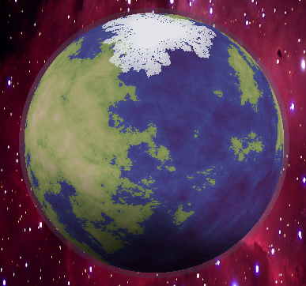
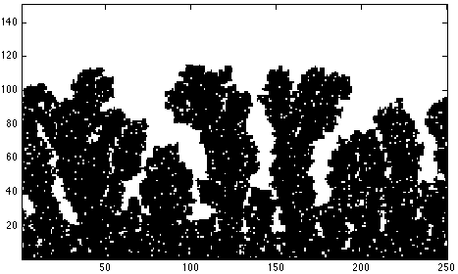
ICE CAPS
Main code then imports selected matrix.
Maps it slightly above the original sphere.
Gray color map to give gradient.
Color gradient is more realistic
Different matrices can be applied to different planet types.
‘Holes’ seem better than continuous sheet.
Some parameters may give fjord like features.

Slide 9
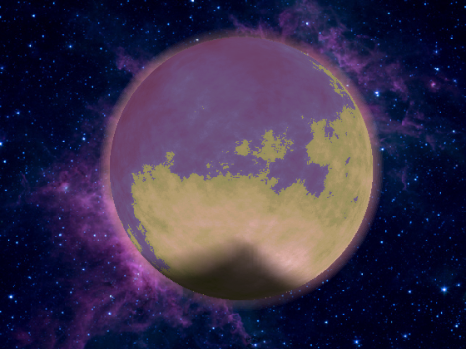
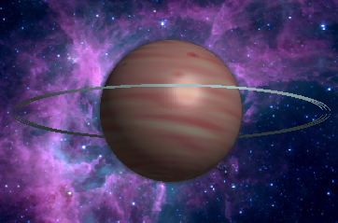
ATMOSPHERE and colormaps
To give the atmosphere an “airy” look, multiple transparent spheres were put around the planet so that it appeared dense at lower elevations and fades as elevation increases.
Colormaps of the atmosphere were made by starting the 3-by-64 matrix at one color and gradually fading to white.
Colormaps for some gaseous planets were made by gradually going from one primary color to a secondary color.

Slide 10
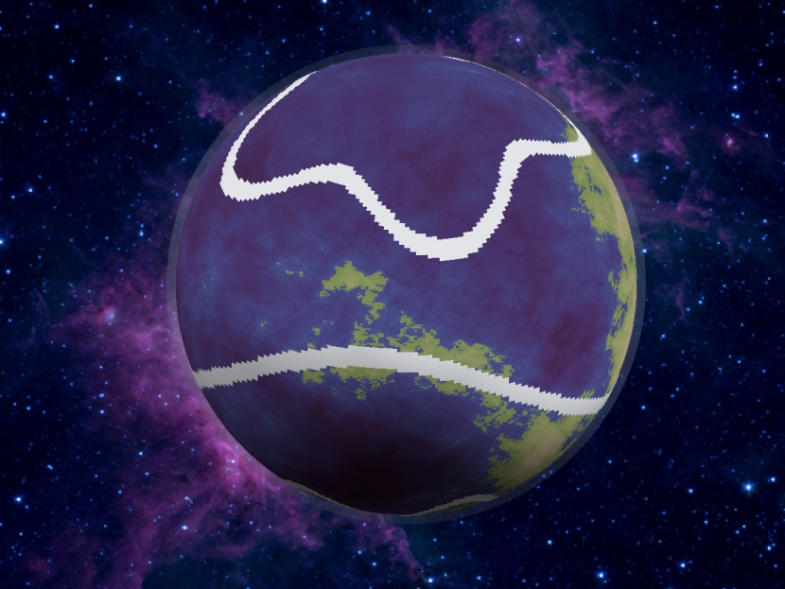
Clouds
To add what could pass for clouds to an earthlike planet
Includes two jet streams and one intertropical convergence zone, with roughly applied Rosby Waves
Includes strong tropical thunderstorm complexes

Slide 11
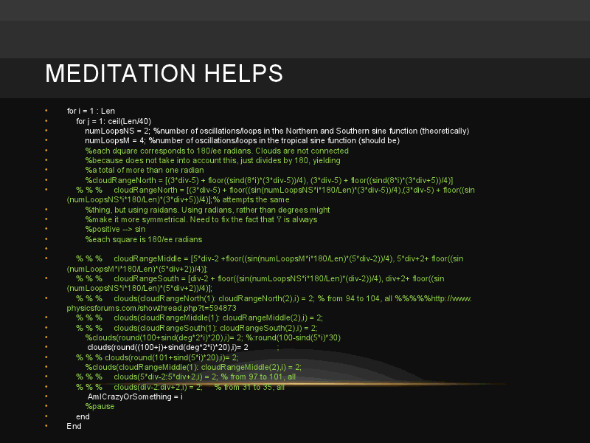

Slide 12
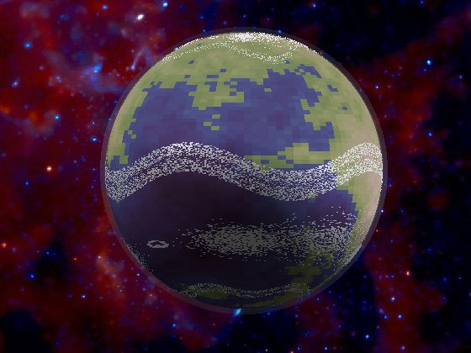
Clouds
First big challenge: to plot the sinusoidal cloud belts on a 200X200 array
Matlab is a pickier eater than you ever were.
Figured out how many degrees each square corresponded to by *360/200
Then used a nested for loop instead of just one for loop
Ikeda map proved less promising than originally hoped, but still managed to produce storm-like features.
Roughly accounts for seasons as well as non-negligible rotation of the earth
Can pick the number of loops for the belts and their thicknesses

Slide 13
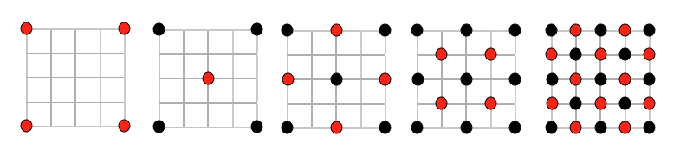
Diamond Square
Useful for generating cloud-like images.
Diamond step: Take the four corners of each square and average them for the center point, adding some random constant to generate a bit of variability.
Square step: Take each pair of corners and average them for the midpoint, adding some random constant to generate variability.
Alternate between two steps until every entry has been assigned a value.

Slide 14
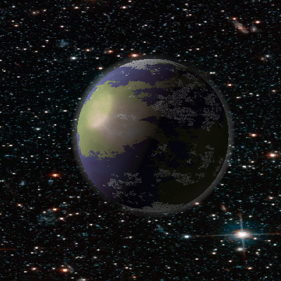
Diamond Square clouds
Set all entries under a certain value to 0, then made 0 transparent to get spread out clouds
Transparency/colormap issues…
Clouds are random– hard to know what to expect

Slide 15
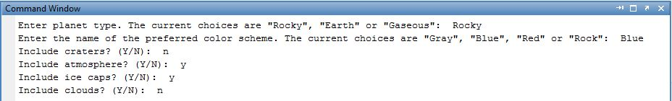
User interface
The user interface is simply some Matlab input functions that allow the user to choose how the planet should look by answering a series of questions.
Allows the user to easily create different types of planets without having to modify the code.

Slide 16
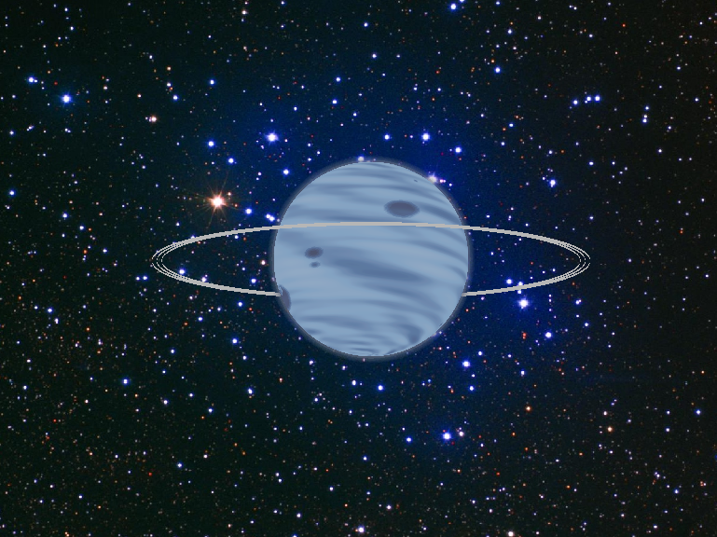
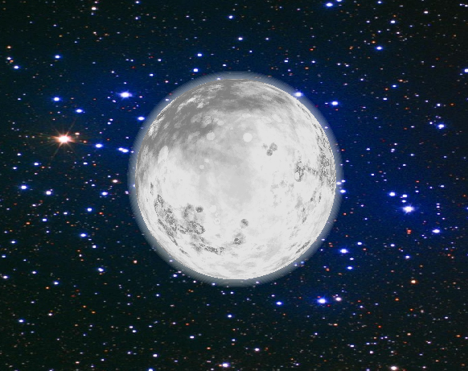
Final Images

Slide 17
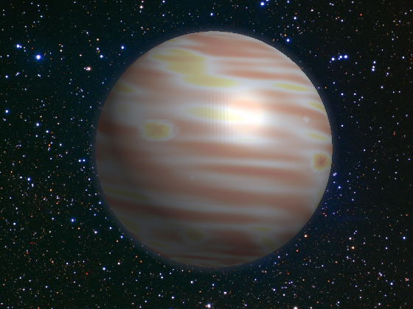
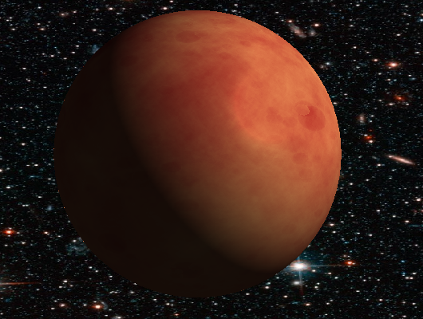
Final Images

Slide 18
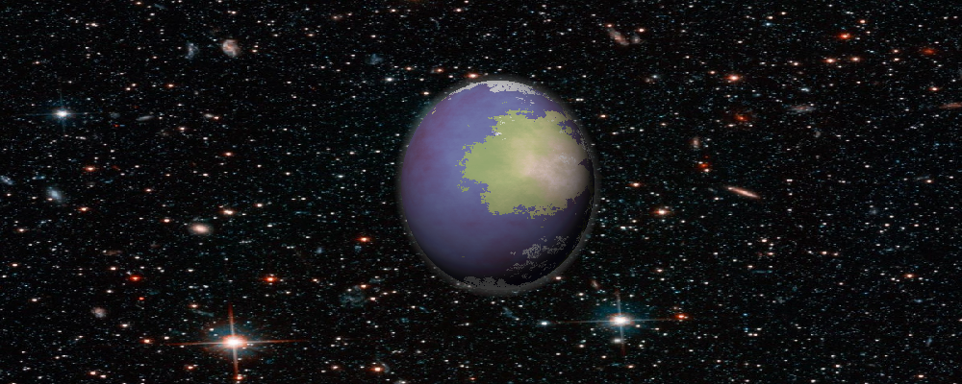
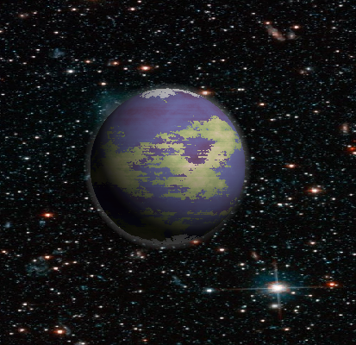
FINAL IMAGES

Slide 19
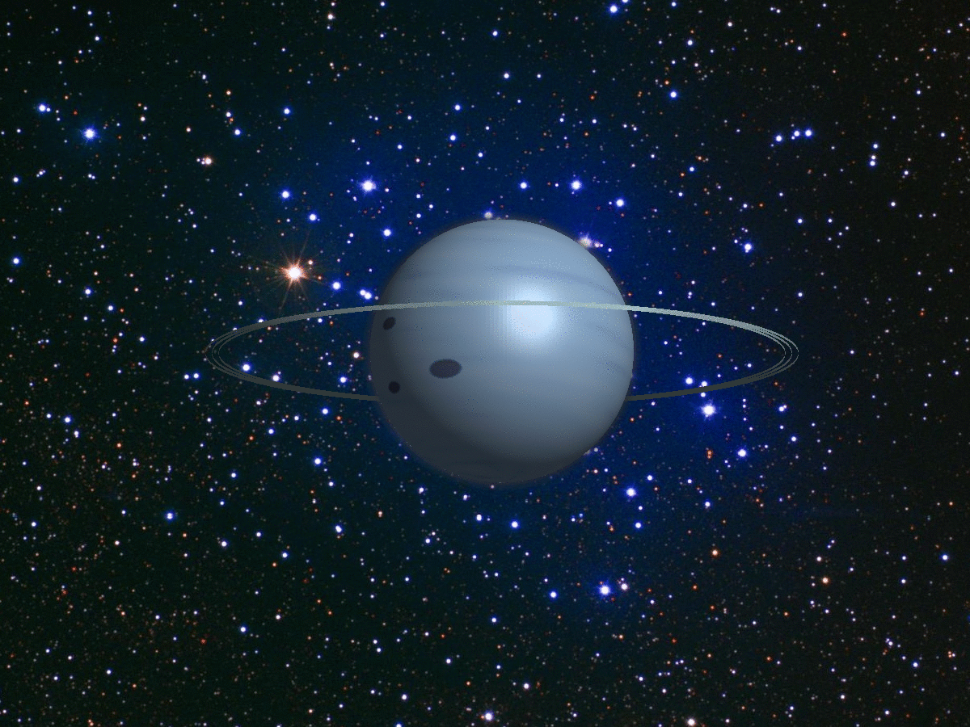

Movies

Slide 20
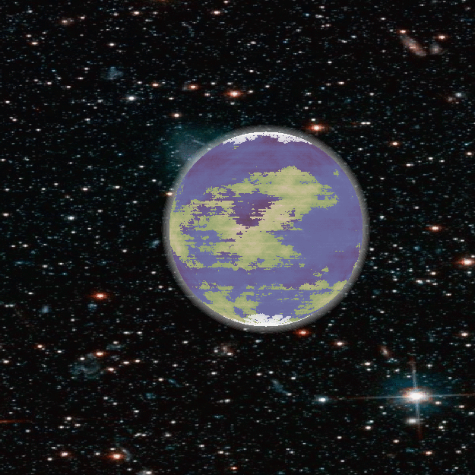
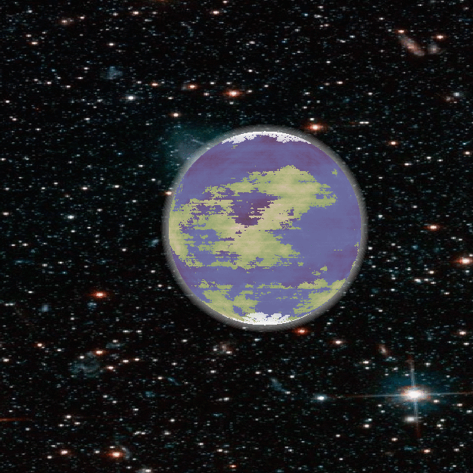
Movies

Slide 21
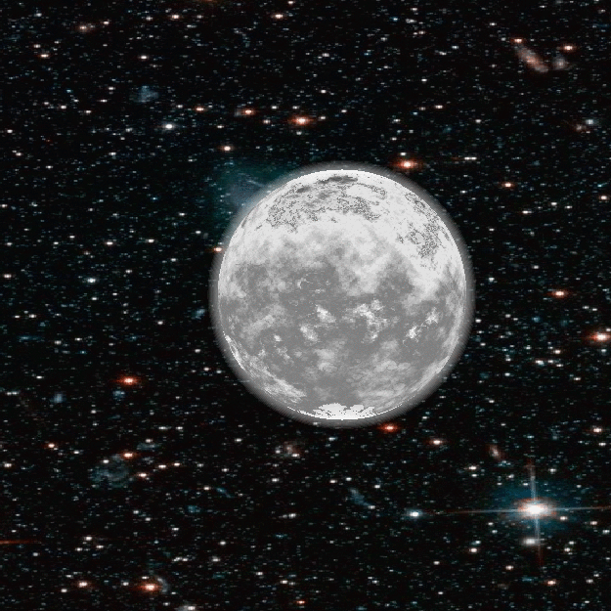

movies

