Slide 1
Grand Canyon Erosion

Slide 2
The Objective
Create an eroded landscape analogous to the Grand Canyon

Slide 3
The Process
First I found a mathematical equation that created a valley when put in the erosion code
for i=1:NX
for j=1:NY
Z(i,j)=30+.1*(sqrt(abs((i^2-j^2)+(i+j))));
if Z(i,j)>38
Z(i,j)=40;
end
end
end
Then I added a small if statement to simulate different rocks with different erosion tolerances
if Z(i,j)>30
n=1.0;
else
n=2.0;
end
Finally I added a couple of hills using the initial hill function from the original code to make the erosion more interesting

Slide 4
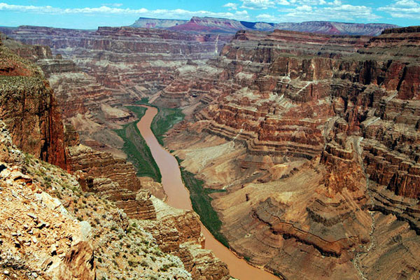
The result

