Slide 1
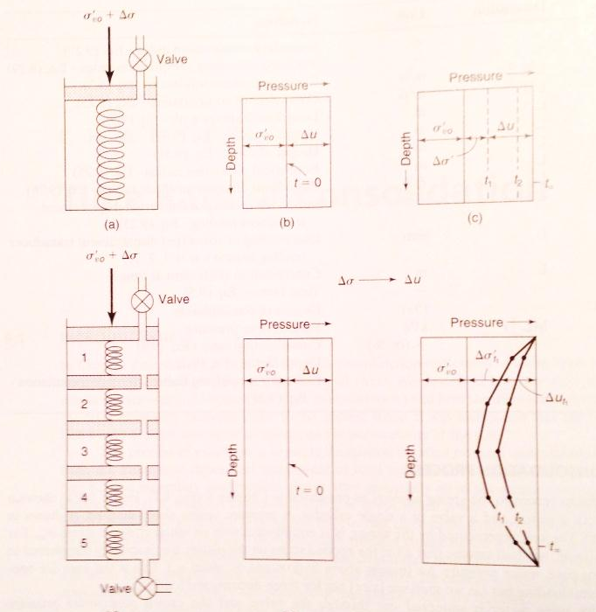
Terzaghi’s 1D Consolidation Theory
Maggie Parks
11/28/12 EPS 109 Final Project
Source: Holtz, Kovacs, Sheahan, Geotechnical Engineering

Slide 2
Example of a Consolidation Problem

Slide 3
Terzaghi 1D Consol Th Second-order partial differential equation Commonly solved with a finite difference approximation, then charts and spreadsheets
Source: Holtz, Kovacs, Sheahan, Geotechnical Engineering

Slide 4
Assumptions: 1. Clay is saturated and homogeneous 2. Doubly drained 3. Darcy’s law applies 4. Soil and water is incompressible 5. Flow is 1D 6. Small Strains 7. Linear relationship between volume change and effective stress

Slide 5
Pore Pressure Dissipation Run “Terzaghi_pp.m”
Chart Solution
PDE Solution
Source: Holtz, Kovacs, Sheahan, Geotechnical Engineering

Slide 6
Pore pressure dissipation leads to increase in effective stress Run “Terzaghi_layers.m”
Based on Chart Solution
Based on PDE Code
Source: Holtz, Kovacs, Sheahan, Geotechnical Engineering

