Slide 1
Carbon Flux Explorer Image Processing and the Future of Oceanography
Hamilton, Christina

Slide 2
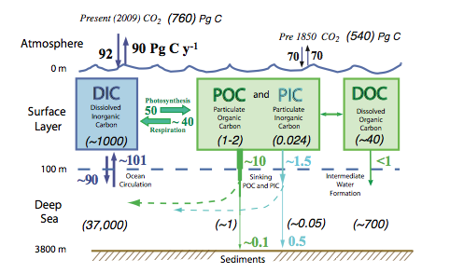
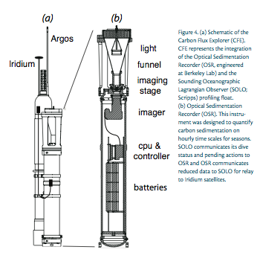
Oceanic Carbon studies via image analysis from Carbon Explorer Robots are the fastest most cost efficient method!
Biological Carbon pump turns over once every 1-2 week and requires real time data(Bishop et all, 2009)
Chemical analysis is too slow, expensive, and requires human effort, with the cost upwards of 40K per day at sea
Global Carbon trajectory models depend on the crucial parameter of carbon remineralization, which is how rapidly POC is converted to dissolved inorganic carbon(DIC) and sinks through the water column
CFE moves vertically in water column or pauses by changing its density
4 hour cycle, cleans lens and takes data, then takes data one the hour for 3 more hours, repeats
Takes:
LED, BCK, POL images
And other readings

Slide 3
Complete Sequence of original LED Images from June 2012 New Horizon Expedition
Image Development:
Read in image
Convert to grayscale
Determine data radius
Subtracts from last cleaning cycle
Convert to binary
Removes lens
Count Particles
Measures total POC area to plot

Slide 4
