Slide 1
Gaussian Wavepacket in an Infinite square well
EPS 109 Presentation
Edgar Dimitrov

Slide 2
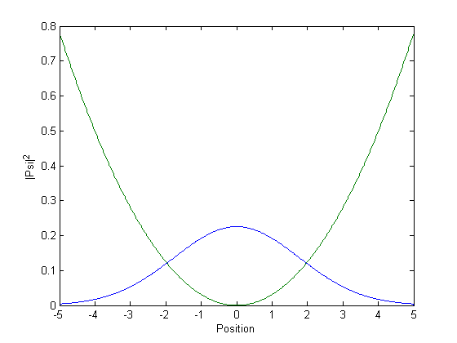
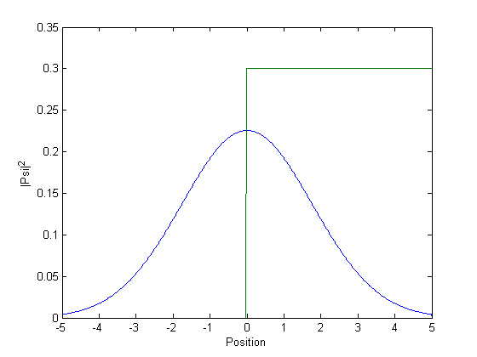
Concepts
1D time dependent Schrodinger equation Solved by discretization then Crank-Nicolson method (average of forwards and reverse newton method) to get values at each time step.
Reference: Numerical investigations of the long time solution of the Schrodinger $$iℏ\frac{d}{dt}\text{ψ}\text{(}\text{x}\text{, }\text{t}\text{) = }[−\frac{ℏ^{2}}{2m}∇^{2}+V(\text{x}\text{)]}\text{ψ}\text{(}\text{x}\text{, }\text{t}\text{)}$$ Because of the imaginary terms, only ${\left|\text{ψ}\text{(}\text{x}\text{, }\text{t}\text{)}\right|}^{2}$ is physically relevant.
Initial distribution: Gaussian Wave packet $\text{ψ}\text{(}\text{x}\text{)=}\frac{1}{\sqrt{σ∗\sqrt{π}}}e^{−{ik}_{0}x}e^{\frac{{−(x−x_{0})}^{2}}{2σ^{2}}}$
Minimum uncertainty $∆x∆p≥ℏ/2$
Potentials: V(x) affects propagation, can be used to simulate various conditions

Slide 3
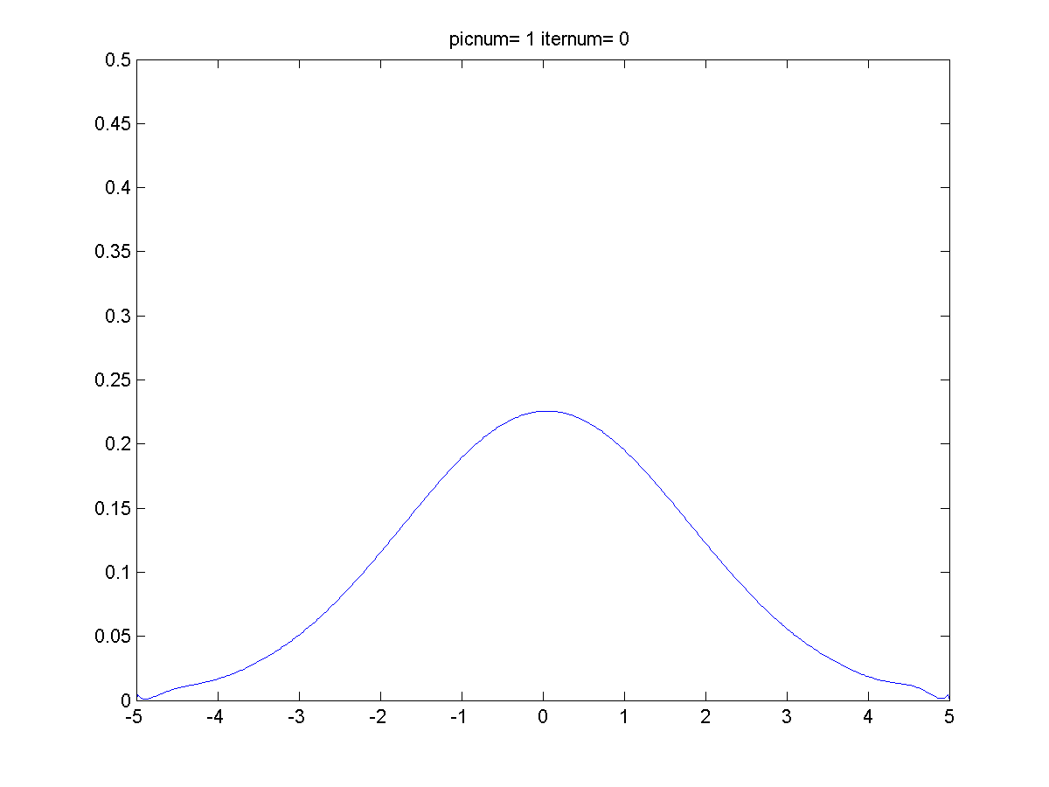
Infinite Square Well V(x)=0

Slide 4
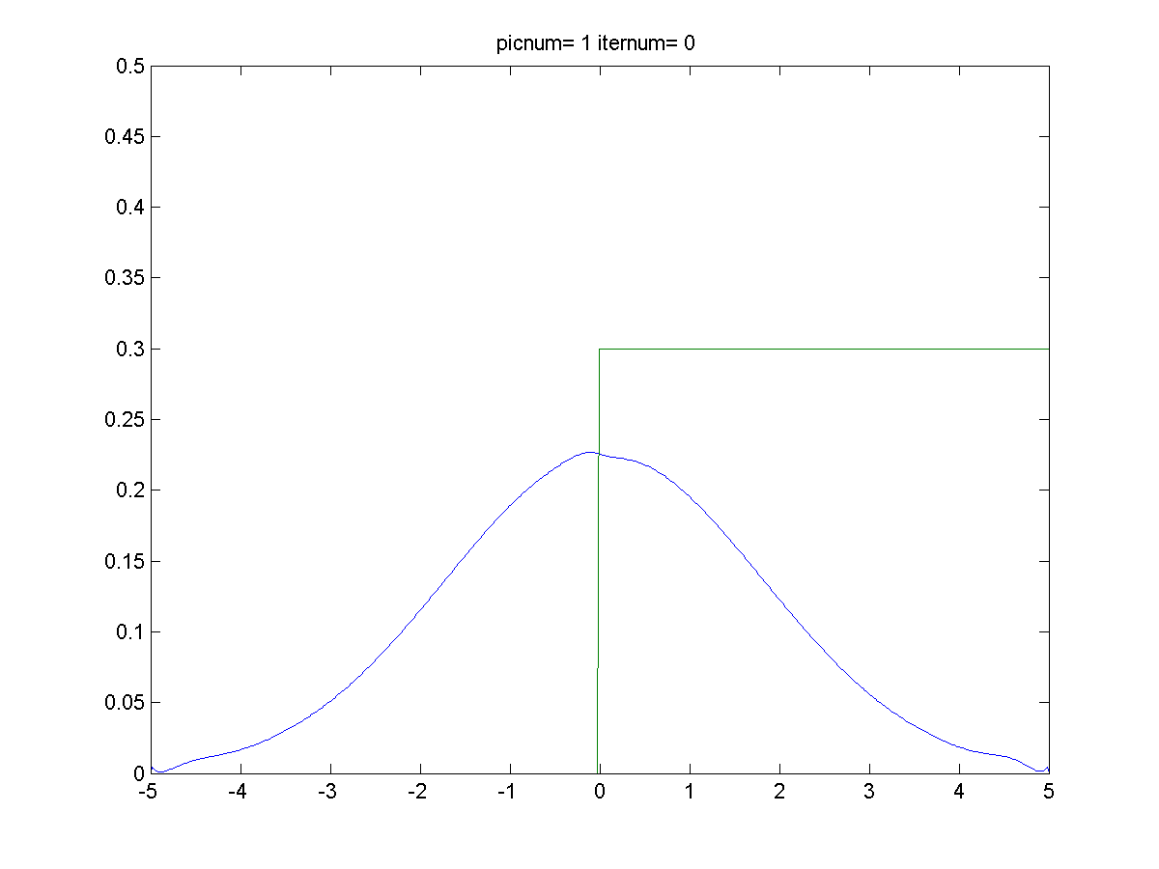
Step Potential V(x)=.3 ; 0>x>5

Slide 5
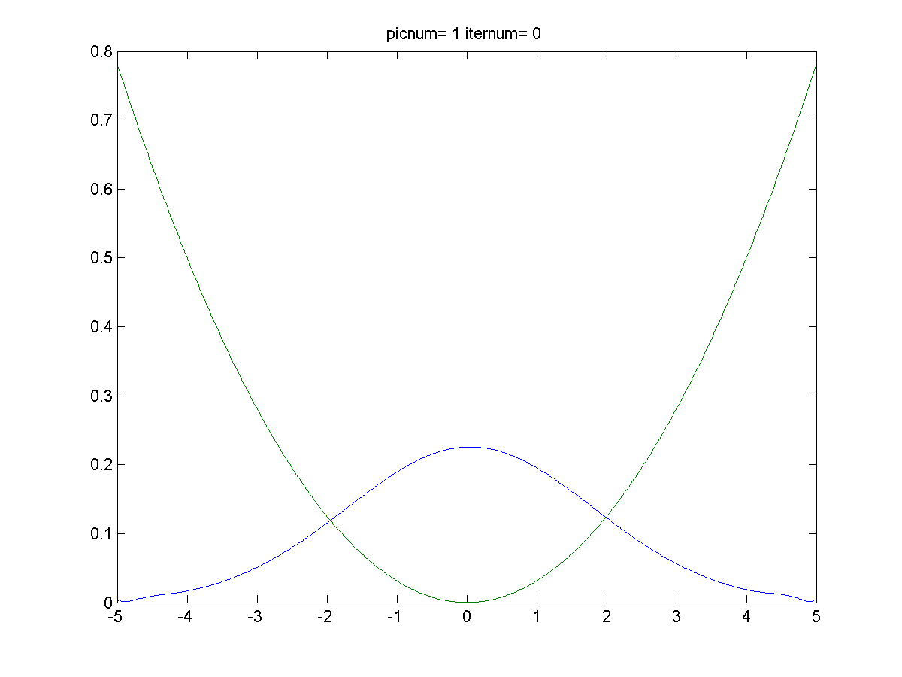
Harmonic oscillator potential V(x)=1/2*m*w^2*x^2

