Slide 1
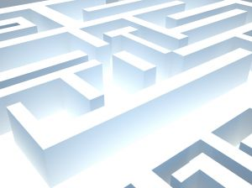
Experimenting with AI: A Pacman Derivative
By: Michael Chamberlain

Slide 2
Goal: To create an intelligent “Pacman” character and intelligent monsters who attempt to chase the character.
. Character can “see” 2 blocks away up, down, left, right and 1 block in each direction diagonally. Monsters can only “see” two blocks up, down, left and right. Everyone moves randomly otherwise.
. Gives the character a slight advantage and 2 blocks of sight minimizes seeing through walls.
Problems
. It’s easy to program ghosts to follow character, however we don’t want the character to die from inaction
. Since there is no diagonal movement, if a monster got right next to the character, he would “stick” to him. Introduced the “smart” variable to fix this while still leaving chase sequences intact.

Slide 3
Run Monsters_and_Man.m
http://i.imgur.com/zdKbd.gif - A gif showing a few chase sequences.
http://i.imgur.com/Fp8yS.gif - Short gif showing the character being caught.

