Slide 1
Construction of a Fractal Planet
By: Andrew Wilkins
EPS 109
Fall 2011

Slide 2
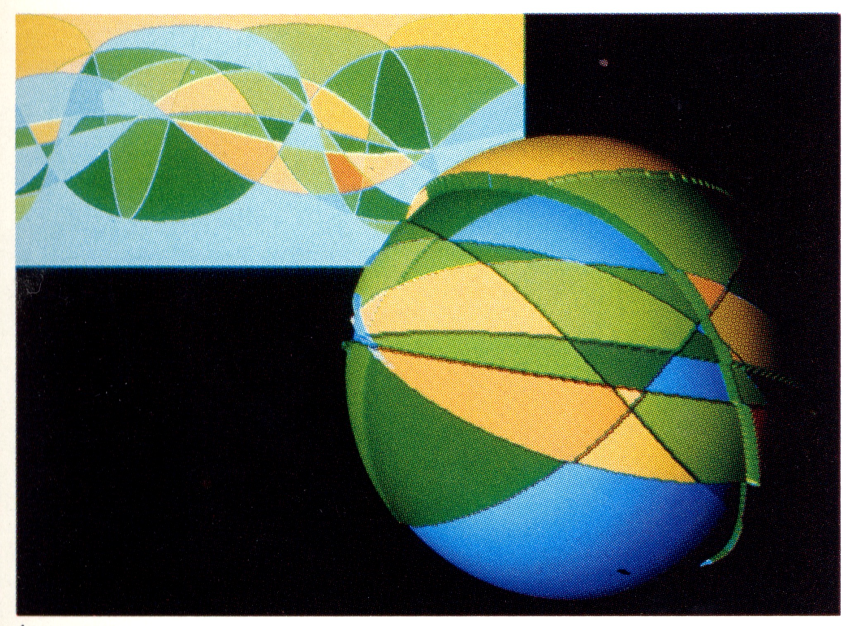
Fractals are found everywhere in nature.
Fractal terrain/planets are especially common in video game design.
Run my code by clicking run!

Slide 3
