Slide 1
Much Simplified Ablation
jason utas

Slide 2
Time-dependent solution to the heat equation
You might recall from lecture/lab/homework that:
-- But we didn’t deal with κ.
Different materials have different properties (and thus different κ values).

Slide 3
η
So…
Where κ is thermal conductivity, Cp = the specific heat, and ρ is the density of a given material.
Also relevant: starting temperature of material and temp. of surroundings. Used a rough estimate of 175°K for the initial temp. of the body and ~2200°K for its surroundings.
Specific heats of materials:
Iron = 0.49 J/kg/K
Stone/Rock (average) = ~0.80 J/kg/K
Thermal conductivities:
Iron = 80 W/mK
Stone/Rock (average) = ~1.7 W/mK
Densities:
Iron = 8g/cm^3
[8000 kg/m^3]
Stone = 2.6g/cm^3
[2600 kg/m^3]

Slide 4
η,
CONTINUED
So…
K-iron = 80 W/mK / (0.49 J/kg/K * 8000 kg/m^3)
K-stone = 1.7 W/mK / (0.80 J/kg/K * 2600 kg/m^3)
and
η-iron = [(10^-4)/(1)]*K-iron = 2.0408*10^-6 *
η-stone = [(10^-4)/(1)]*K-stone = 4.3367*10^-8 *
-> too small to show an effect over reasonable time period
-> multiplied both by 10^5
*time step used was 10^-4 & (delta x) was one unit, so (delta x)^2 = 1
I assigned an arbitrary value to η-surroundings; the important thing is that it is uniform over the entire outer surface.

Slide 5
The code
This runs with the same time-dependent heat equation we used in lab, but conditional statements were added to remove particles when they crossed the melting point of stone (yellow) and iron (red).
The organization of the two materials to be ablated is randomized each time.

Slide 6
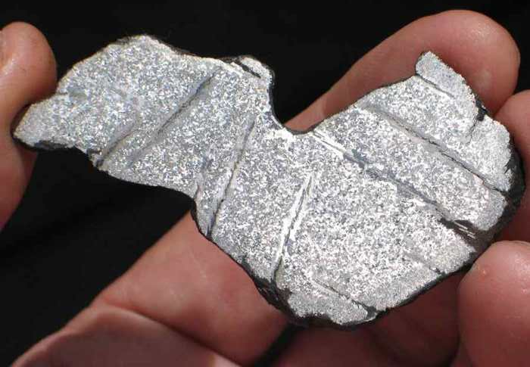
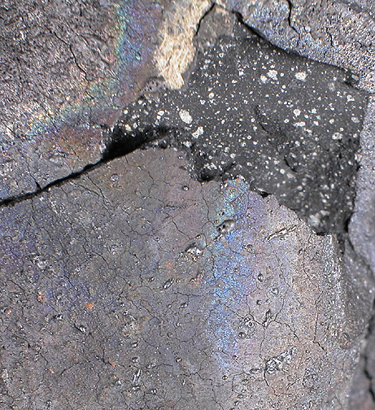
Results
Melting points of stone and iron were set to 1500 and 1800K, respectively.
Important thing to note; material melted and disappeared far more quickly than heat penetrated. This is true of meteorites, where the outer ~1/10 – 2mm melts, and the remainder is largely unaltered.
http://catchafallingstar.com/murchison723i.JPG
http://www.arizonaskiesmeteorites.com/AZ_Skies_Links/NWA_2428/NWA-2428-1/IMG_8808.jpg

Slide 7
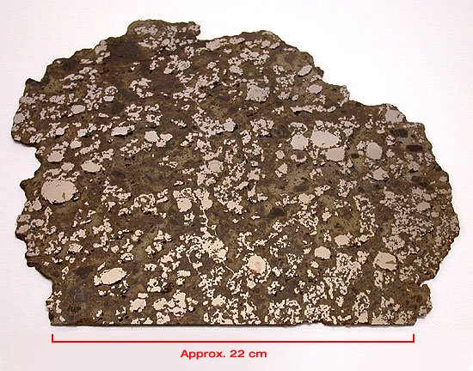
Real-life analogy

Slide 8
Problems?
The model is realistic in that the outer surface ablates far more quickly than heat can penetrate the body, but…
In reality, atmospheric ablation is not simply the influx of heat; intense pressures and complex surface interactions are also taking place. The rapid melting and stripping of heated surface material keeps the interior at nearly the same temperature as it was when it entered the atmosphere.
In all cases, the heat and pressure are not applied evenly, giving real meteor(ite)s greater chances of experiencing turbulent motion and breaking up, resulting in more complex systems.

