Slide 1
Diffusion Limited Aggregation in 3D
Pinchao Li | EPS109

Slide 2
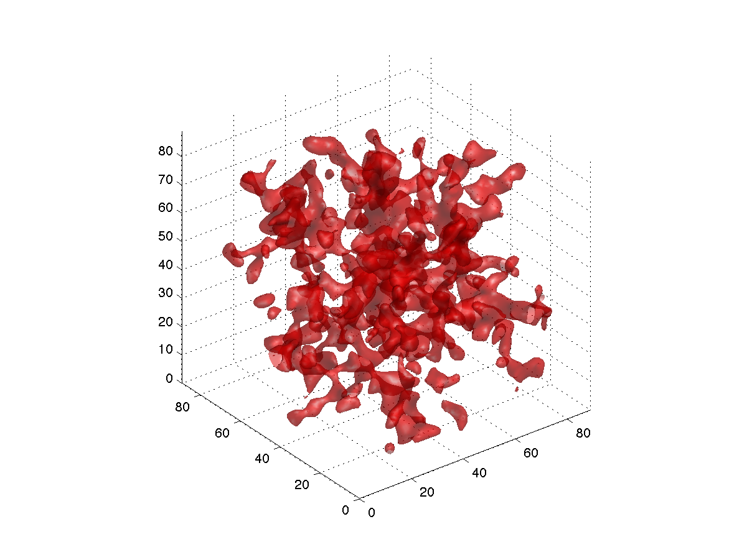
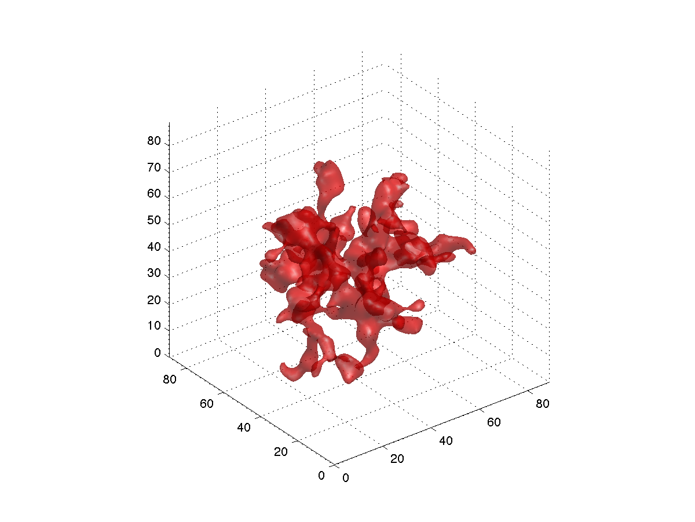
Effects similar to 2D version
Sticking probability has similar effects. Lower=denser, smoother. Video: 10%. Boundaries sealed.
Tried spherical container (particles start from center): results expected but bad picture
Start with particle at center. 30x30. 3000 particles, 20 per frame

