Slide 1
Traffic Flow
Tam Visher

Slide 2
MD-type Approach
Other ways to think about it: macro- fluids, micro- follow the leader
From a car’s perspective, speed and lane changes are determined by only the closest cars nearby. The car in front is important for speed changes and all the cars nearby are important in lane changes.

Slide 3
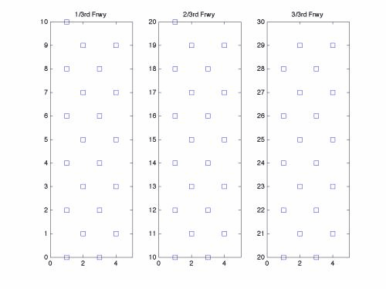

Speed & Lane Change Rules
Speed Rules: Hooke’s law with varying k’s depending on distance between cars. Magnitude of acceleration bound by individual driver’s max acceleration.
Lane change rules….

