Slide 1
Double Pendulum
By: Rosa Nguyen
EPS 109 – Fall 2011

Slide 2
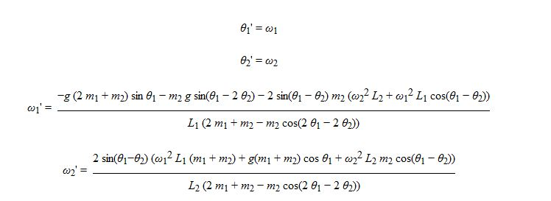
Double Pendulum
- A simple pendulum where another point of movement can now occur (or another rod added at the end).
- A dynamical system where its motion is dictated by a set of ODE’s, which are derived from the initial position. Net forces, manipulation, and rewrite of derivatives to have first order equations.
- Sensitive to initial conditions and can lead to chaos/unpredictability.
- This sets up our conditions to solve the ODE’s with our Runge Kutta method in a similar fashion with past homeworks.

Slide 3
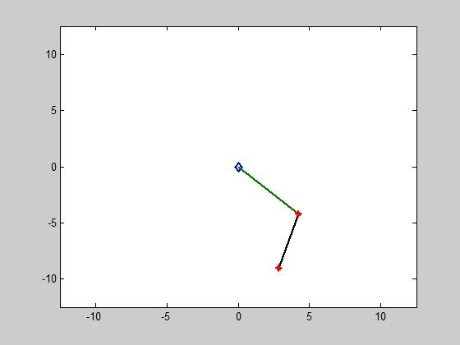
Run “double_pendulum.m” which calls on “ode2.m”

