Slide 1
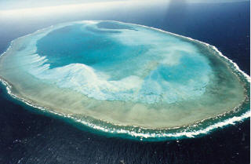
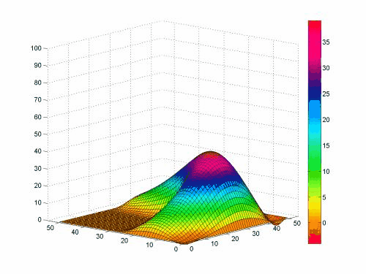
atoll_formation
Nin Gan 11/28/11
EPS 109 B.Militzer

Slide 2
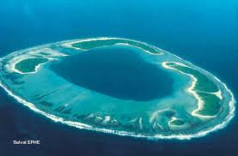
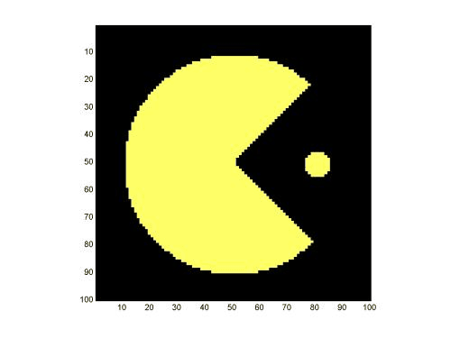
A seamount gains a fringing reef
Ridge push moves the seamount away from the mid-ocean ridge into deeper water- appears to sink
The coral continues to grow to maintain the same depth
initial_conditions_add_hill.m
fringing_reef.m
for i = 1:n
atoll_formation.m
{erosion
physical sinking}
fringing_reef.m
end

Slide 3
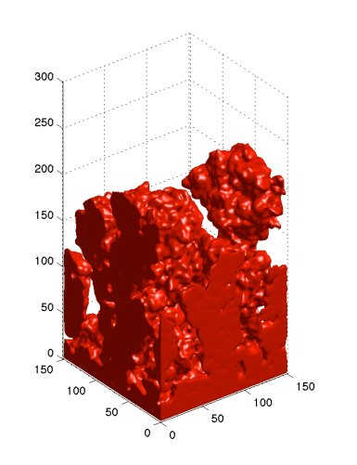
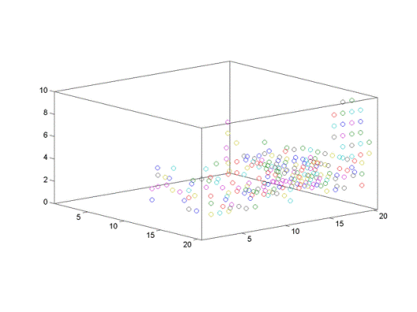
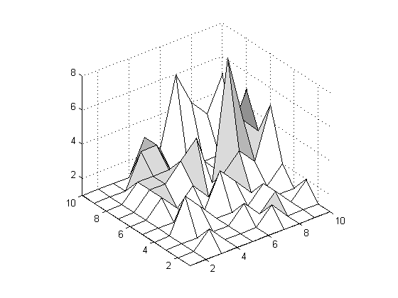
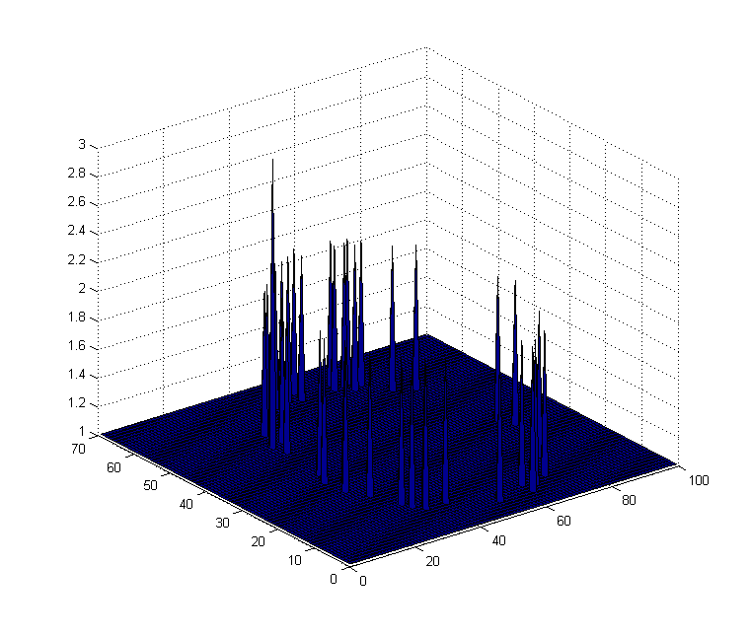
3-D Diffusion-limited aggregation
looks like coral
Pseudo DLA
zT,zB,xL,xR,yU,yD
if A(x,y) == z
A(x,y) = A(x,y) + 1;
end
Arrange in a ring

Slide 5
