Slide 1
Halloween Checkerboard made by Brandon Johnson
Matlab file: BrandonJdlacode
For my movie I modified the code from the lab on diffusion limited aggregation so that two particles diffuse in a checkerboard pattern
Modifications
Created two particle types and arranged the initial layer with alternating types
Before for created variable called type and set equal to one
Inside the for loop created new variable called othertype and set equal to 3 minus type
Then counted the number of similar and different particles in contact with current particle
Put in probabilities of sticking for all possible scenarios
Set the resting position of the particle equal to type, then set type equal to othertype
Paraphrased Code
A(1:2:maxX,1) = 1;
A(2:2:maxX,1) = 2;
.
type=1
for i = 1:nParticles
.
othertype=3-type
while 1
.
(Count type and othertype particles on the side of current particle)
.
(Probabilities for all case)
.
A(x,y) = type;
type=othertype; % mark site as taken
.
colormap(hot);
.
end
end

Slide 2
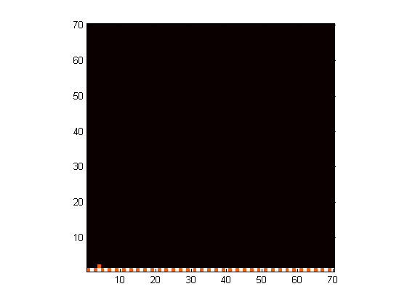
Halloween Checkerboard made by Brandon Johnson
Initial State

Slide 3
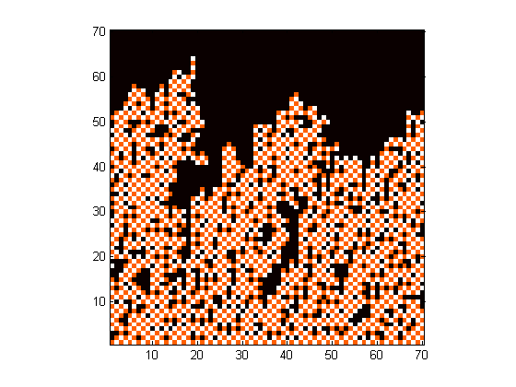
Halloween Checkerboard made by Brandon Johnson
Final State

Slide 4
Halloween Checkerboard made by Brandon Johnson
Movie

